Slide 1

Theory of Computation CSE ( CET2008B) TY BTech Unit I Introduction to Automata

Slide 2
Course Objective & Course Outcomes
Course Objectives:
By participating in and understanding all facets of this Course a student will be able:
To understand the basics of automata theory and its operations.
To understand problem classification and problem solving by machines.
To study computing machines by describing, classifying and comparing different types of computational models.
To understand the fundamentals of decidability and computational complexity.
Course Outcomes:
After successful completion of this course students will be able:
To construct Finite State Machines to solve problems in computing.
To build mathematical expressions and syntax verification for the formal languages.
To construct and analyze Push Down Automata and Turing Machine for formal languages.
To classify the problems of decidability and complexity.

Slide 3
Text Books & Reference Books
Text Books
John C. Martin, Introduction to Language and Theory of Computation, TMH, 3rdEdition, ISBN: 978-0-07-066048-9.
Vivek Kulkarni, Theory of Computation, Oxford University Press, ISBN-13: 978-0-19-808458-7.
Reference Books
K.L.P Mishra,N. Chandrasekaran,Theory of Computer Science (Automata, Languages and Computation), Prentice Hall India, 2nd Edition.
Michael Sipser, Introduction to the Theory of Computation,CENGAGE Learning, 3rd Edition, ISBN:13:978-81-315-2529-6.
Daniel Cohen, Introduction to Computer Theory, Wiley India, 2nd Edition, ISBN: 9788126513345.
Kavi Mahesh, Theory of Computation: A Problem Solving Approach, 1st Edition, Wiley-India, ISBN: 978-81-265-3311-4.

Slide 4
Unit I
Introduction to Formal language, Basic concepts: Symbol, Alphabet, String
Introduction to Finite Automata, State transition graph, Transition table, Acceptance of a string, Acceptance of a Language
Deterministic finite Automata (DFA)-Formal Definition
NonDeterministic finite Automata (NFA)-Formal Definition
NonDeterministic finite Automata (NFA) with epsilon transition
Equivalence of NFA and DFA, Conversion from NFA to DFA, Conversion from NFA with epsilon transition to DFA
Finite Automata with output: Moore and Mealy Machine, Moore to Mealy conversion, Mealy to Moore conversion

Slide 5
Planner - Lectures
Lecture No | Topics Covered
1 | Introduction to TOC, Introduction to Formal language, Basic concepts: Symbol, Alphabet, String
2 | Introduction to FA, State transition graph, Transition table, Acceptance of a string, Acceptance of a Language,
3 | DFA -Formal Definition, NFA-Formal Definition, NFA with epsilon transition, Equivalence of NFA and DFA
4 | Conversion from NFA to DFA
5 | Conversion from NFA to DFA (cont), Conversion from NFA with epsilon transition to DFA
6 | Conversion from NFA with epsilon transition to DFA (cont)
7 | Minimization of FA
8 | Finite Automata with output: Moore and Mealy Machine Moore to Mealy conversion
9 | Mealy to Moore conversion
Planner - Tutorial
Tutorial No | Topics Covered
1 | FA, DFA, NFA, FSM
2 | Conversion from NFA to DFA
3 | Moore and Mealy machines and Inter-conversions

Slide 6
TOC Covers
Course is about models of computation, their power, and relationships.
Hierarchy of models of increasing power:
-DFA < PDA < TM.
For each model, we study:
-What can be computed.
-What cannot be computed.
Automata theory is the study of abstract computing devices or “machines”

Slide 7
Automata theory
The study of abstract 'mathematical' machines or systems and the computational problems that can be solved using these machines.
These abstract machines are called automata.
Automata theory is also closely related to formal language theory, as the automata are often classified by the class of formal languages they are able to recognize.
An automaton can be a finite representation of a formal language that may be an infinite set.
Automata are used as theoretical models for computing machines, and are used for proofs about computability.

Slide 8
History of TOC
1930-45: Alan Turing studied Turing machine
Describe boundary between what a computing machine could do and what it could not do
1940-50: Researchers studies Finite Automata
Late 1950s: N. Chomsky studied formal “Grammars”
1969-70: S. Cook extended Turing’s study
Separated problems that can be solved efficiently by computers and the problems that can be solved theoretically, but takes so much time by computers to solve

Slide 9
Application of TOC
Finite Automata:
Software for designing and checking behavior of digital circuits
The “Lexical Analyzer” of a compiler
Software for scanning large bodies of text
E.g. to find occurrences of words in collections of web pages
Software for verifying systems of all types that have a finite number of distinct states
E.g. communication Protocols

Slide 10
Application of TOC (cont…)
Turing Machine:
Prototype/Abstract of modern computer
To find out what a computer can do and what it can not do
Help us understand what we can expect from our software
To decide, whether we can solve the problem, which requires more time to solve, in less amount of time.

Slide 11
Basic Definitions
Alphabet - a finite set of symbols.
Notation: Σ .
Examples: Binary alphabet {0,1}, English alphabet {a,...,z,!,?,...}
String over an alphabet Σ - a finite sequence of symbols from Σ.
Notation: (a) Letters u, v, w, x, y, and z denote strings.
(b) Convention: concatenate the symbols.
No parentheses or commas used.
E.g: 0000 is a string over the binary alphabet.
a!? is a string over the English alphabet.
Language over alphabet Σ - a set of strings over Σ.
Notation: L.
E.g:
{0, 00, 000, ...} is an "infinite" language over the binary alphabet.
{a, b, c} is a "finite" language over the English alphabet.

Slide 12
Basic Definitions (cont…)
Empty string: e or ε denotes the empty sequence of symbols.
Empty Language: Empty set of strings.
Notation: Ф
Regular Language- a finite set of symbols.
L is called regular Language if there is some automaton that accepts L.
E.g.:
Σ* , Even length of strings, strings containing abba are regular Languages.

Slide 13
Basic Definitions (cont…)
Difference Between Formal Language and Natural Language
Formal Language | Natural Language
1. All the rules are stated explicitly | 1. Not necessarily rules to be stated explicitly. It is a medium of communication.
2. Considered as Symbols on papers | 2. Expressions of ideas in Natural way.
3. In formal Languages we are interested in the form of strings of symbols and not meaning | 3. We are interested in Meaning than only strings.

Slide 14
Basic Machine and Finite State Machine
Basic Machine:
A machine that recognizes input set I and produces output set O, where I & O are finite.
Machine Function(MAF): I-> O
Deals with what output is generated, not how output is generated
Finite State Machine (FSM):
A machine that has a finite number of internal states. This state in a machine alters suitably when the machine receives an input and generates the required output such a model is called a Finite State Machine(FSM).
Deals with what internal state the machine has, and how each state behaves on receiving different intermediate inputs
It consists of a pair of functions as
Machine Function (MAF): I × S-> O
State Function (STF): I × S-> S
Behavior of such machines can be completely determined.
Notes:
Look-up procedure-output combination of input.
No memory nor internal states.

Slide 15
Finite State Machine
Examples:
Design FSM for binary adder
Design FSM for divisibility-by-3 tester for decimal number

Slide 16
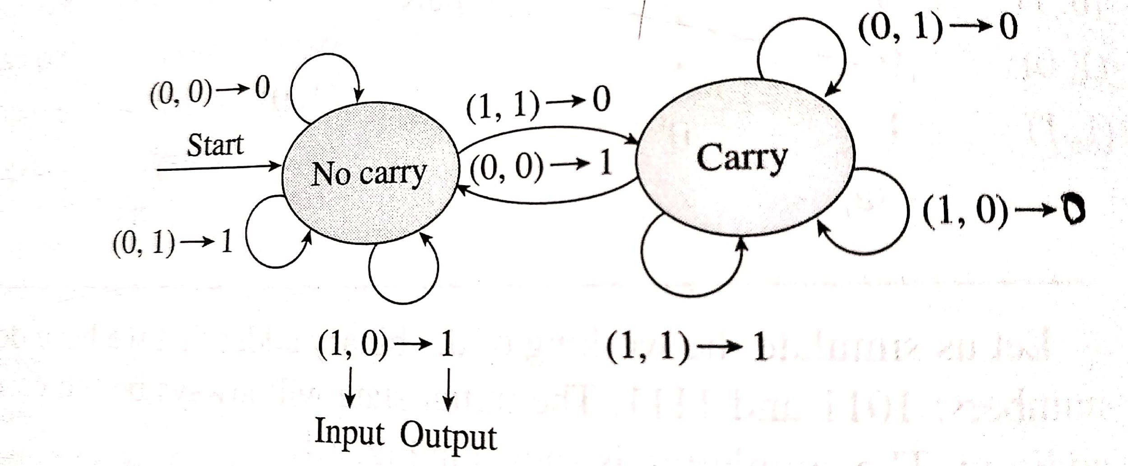
Finite State Machine
Solution for Example 1:
I = {(0,0), (0,1), (1,0), (1,1)}
O={0,1}
States: S= {carry, no carry}
Transition Graph for binary adder

Slide 17
Finite State Machine
Solution for Example 2:
I = {0,1,2,3,4,5,6,7,8,9}
O={0,1}
Output: Divisible by 3: output is 1
Not divisible by 3: output is 0
States: S= {S₀,S₁,S₂}
S₀: 0-remainder state
S₁: 1-remainder state
S₂: 2-remainder state

Slide 18
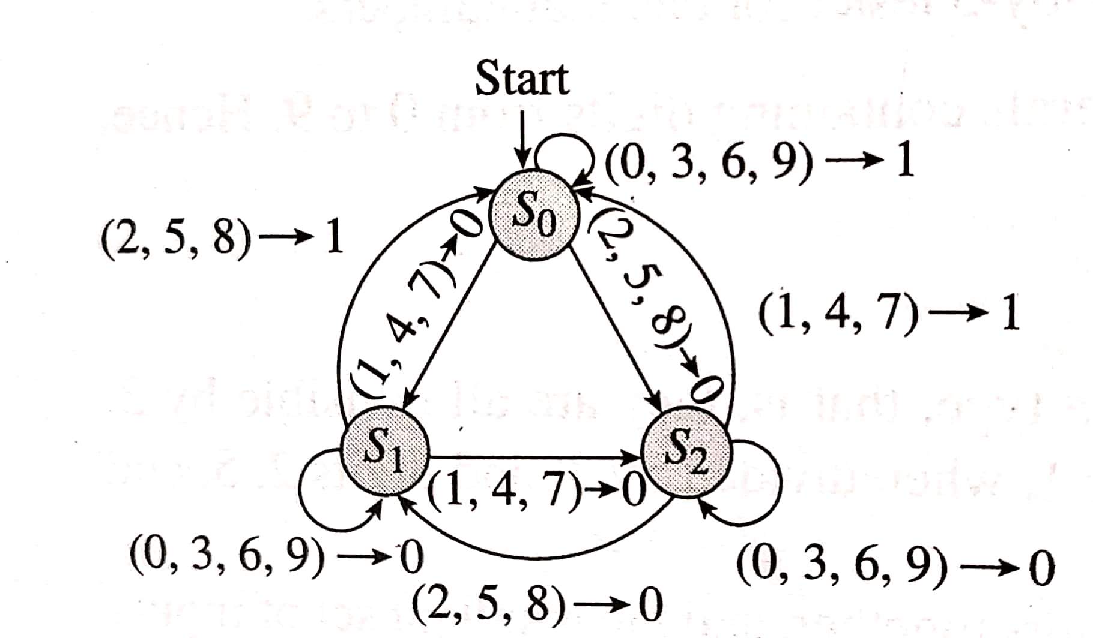
Finite State Machine (cont…)
Transition Graph for divisibility-by-3 tester

Slide 19
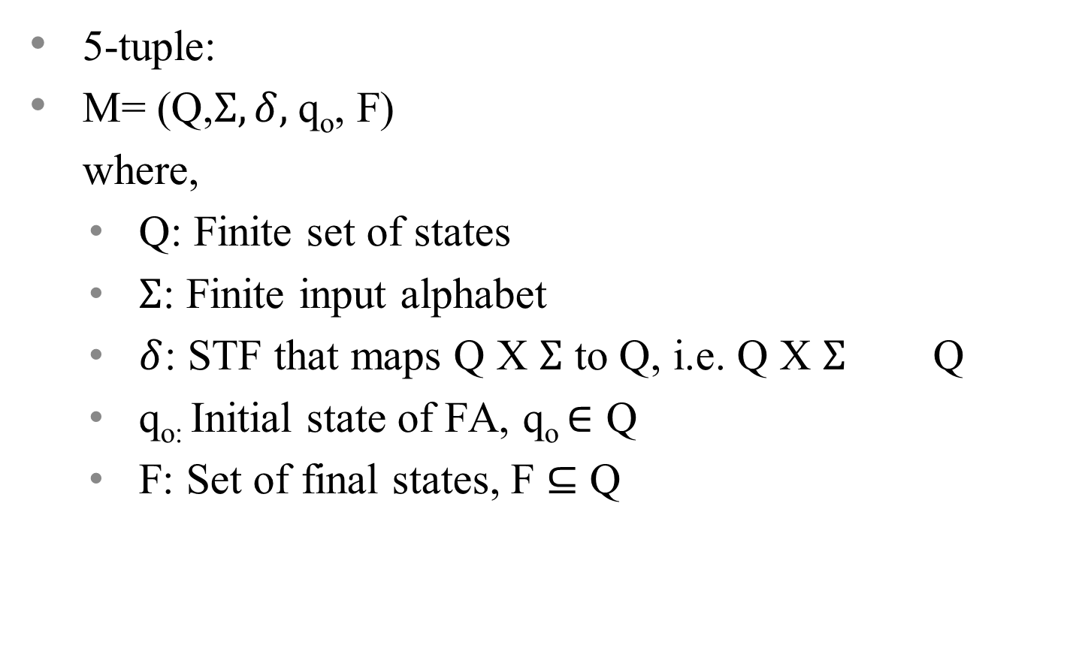
Finite Automata

Slide 20
Finite Automata (cont…)
Finite number of states
No memory to store intermediate results
Limited power due to lack of memory
Input string is considered to be accepted, if the FA resides in any of the final states
Input string is considered to be rejected, if the FA resides in any of the non-final states

Slide 21
Finite Automata (cont…)
Input
String
Output
Finite
Automaton
String

Slide 22
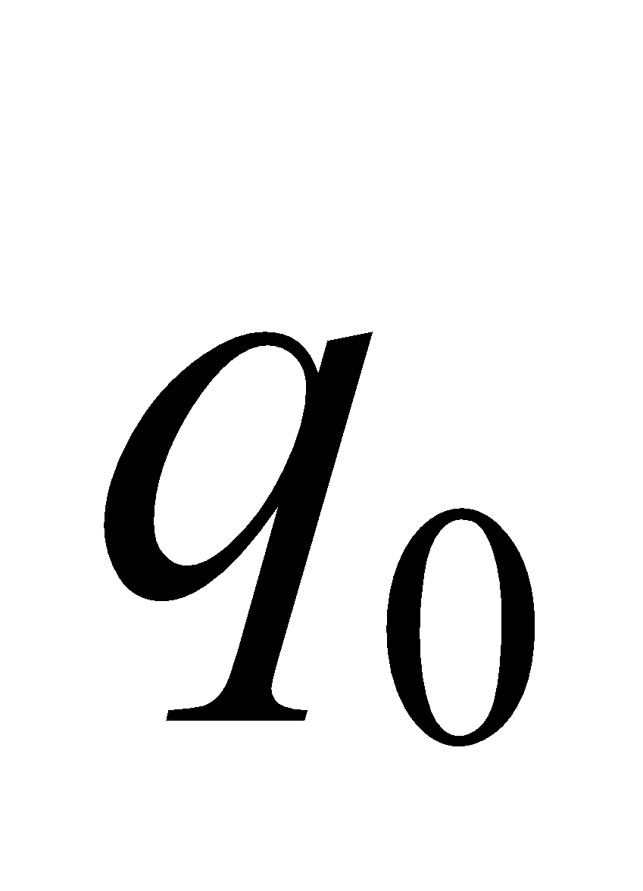
Block diagram of FA
0
0
1
Input Tape
Tape Head
Finite Control
Tape is divided into units ,each containing one symbol of the i/p string from Σ.
Read the current letter of input under the tape head.
Transit to a new state depending on the current input and the current state, as dictated by the transition function δ(q_{i},a)=q_{j.}
Halt after consuming the entire input.

Slide 23
Designing FA
Accept strings consisting of a & b, that has at least one ‘a’
i) Min string :a
ii)∑ ={a,b}
b
a
q₀
q₁
a,b

Slide 24
FA Examples
Construct a FA to recognize language containing strings ending with ‘10’
2. Construct a FA to recognize language containing
strings ending with ‘101’
3. Construct a FA to recognize language of strings
with exactly two 0s anywhere
4. Construct a FA to recognize language containing
strings starting with ‘a’
5. Construct a FA to identify string containing even
number of ‘a’s over ∑ ={a}

Slide 25
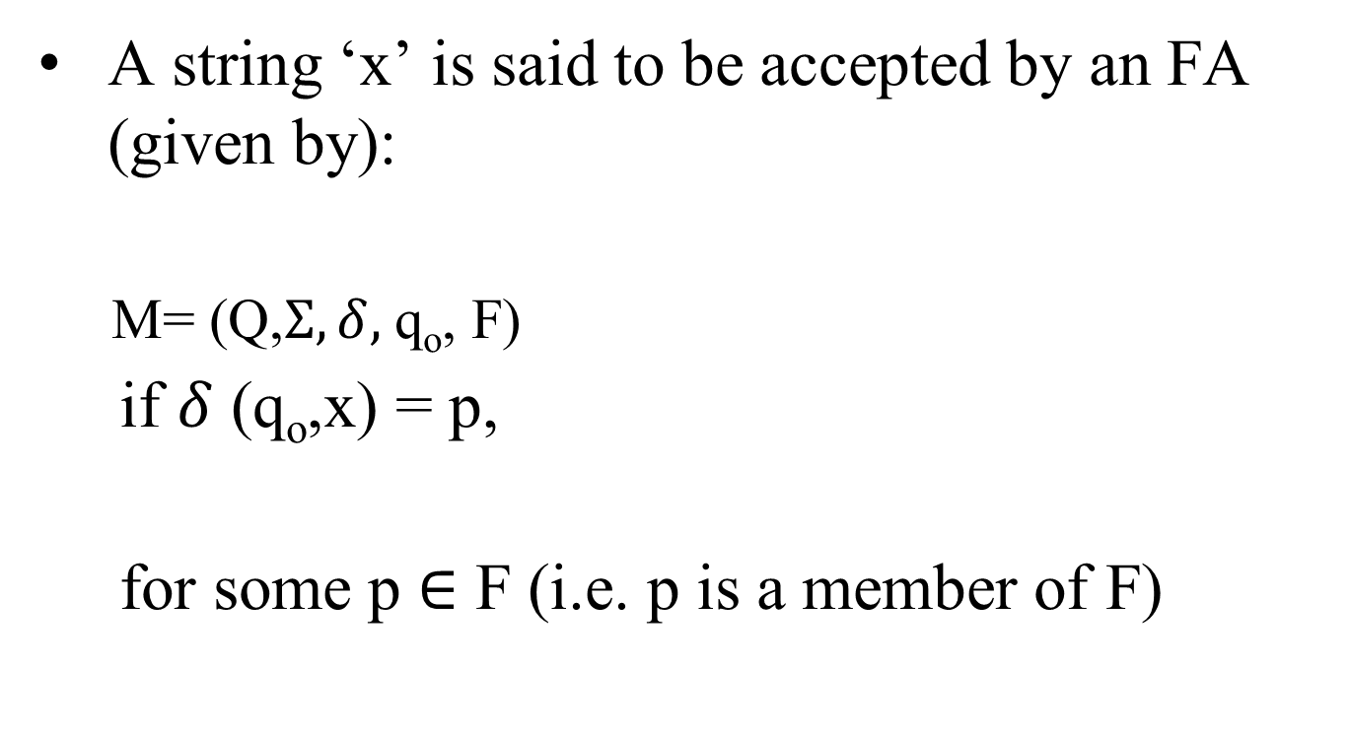
Acceptance of a String

Slide 26
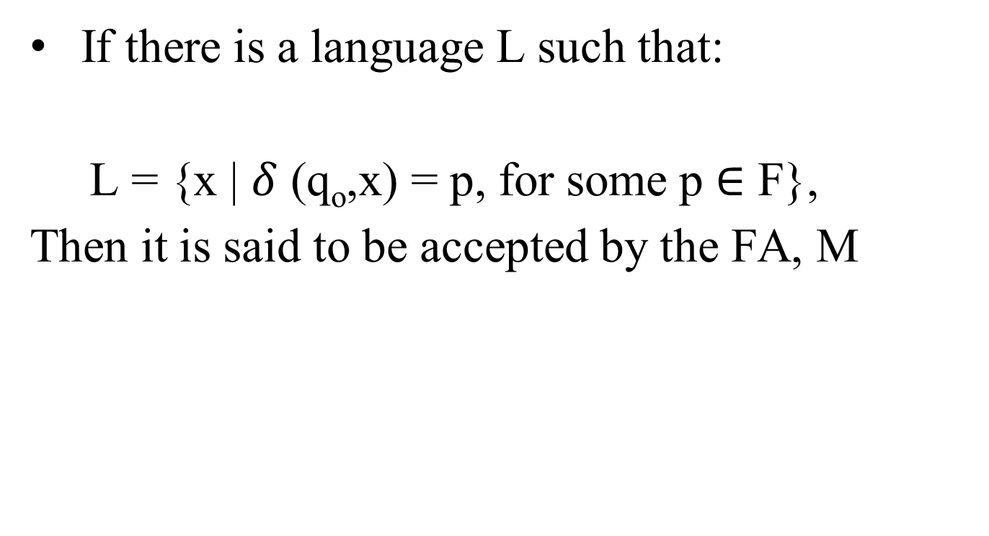
Acceptance of a Language

Slide 27
Deterministic Finite Automata
An FA is said to be deterministic, if for every state there is a unique input symbol, which takes the state to the required next unique state
Given a state Sj, the same input symbol does not cause the FA to move into more than one state-there is always a unique next state for an input symbol

Slide 28
DFA parts
TRANSITION GRAPH
q₀
a
q₁
b
q₂
b
q₃
a
a
b
a
b
q₄
a
b

Slide 29
DFA parts
q₀
a
q₁
b
q₂
b
q₃
a
a
b
a
b
q₄
a
b
STATES : {q₀ , q₁, q₂, q₃, q₄}

Slide 30
DFA parts
q₀
a
q₁
b
q₂
b
q₃
a
a
ACCEPTING STATE
b
a
b
q₄
a
b

Slide 31
DFA parts
NON-ACCEPTING STATE
q₀
a
q₁
b
q₂
b
q₃
a
a
b
a
b
q₄
a
b

Slide 32
DFA parts
q₀
a
q₁
b
q₂
b
q₃
START
STATE
a
a
b
a
b
q₄
a
b

Slide 33
DFA parts
ALPHABET:
Σ = {a,b}
q₀
a
q₁
b
q₂
b
q₃
a
a
b
a
b
q₄
a
b

Slide 34
DFA parts
ALPHABET:
Σ = {a,b}
q₀
a
q₁
b
q₂
b
q₃
a
a
b
a
b
TRANSITION
q₄
a
b

Slide 35
DFA parts
ALPHABET:
Σ = {a,b}
q₀
a
q₁
b
q₂
b
q₃
a
a
b
a
b
q₄
a
b
Exactly one transition
from every state under
each symbol in the alphabet.

Slide 36
DFA parts
ALPHABET:
Σ = {a,b}
q₀
a
q₁
b
q₂
b
q₃
a
a
b
a
b
q₄
a
b
Exactly one transition
from every state under
each symbol in the alphabet.

Slide 37
DFA parts
q₀
a
q₁
b
q₂
b
q₃
a
a
b
a
b
q₄
a
b

Slide 38
DFA transition graph
q₀
a
q₁
b
q₂
b
q₃
a
a
b
a
b
q₄
a
b
JUNK or TRAP STATE

Slide 39
DFA (cont…)
q₀
a
q₁
b
q₂
b
q₃
a
a
TAPE
b
a
b
q₄
a
b

Slide 40
DFA (cont…)
Input string: abb
q₀
a
q₁
b
q₂
b
q₃
a
a
bba
b
a
b
q₄
a
b

Slide 41
DFA (cont…)
Input string: abb
q₀
a
q₁
b
q₂
b
q₃
a
a
a
bb
b
a
b
q₄
a
b

Slide 42
DFA (cont…)
Input string: abb
q₀
a
q₁
b
q₂
b
q₃
a
a
bb
b
a
b
q₄
a
b

Slide 43
DFA (cont…)
Input string: abb
q₀
a
q₁
b
q₂
b
q₃
b
a
a
b
b
a
b
q₄
a
b

Slide 44
DFA (cont…)
Input string: abb
q₀
a
q₁
b
q₂
b
q₃
a
a
b
b
a
b
q₄
a
b

Slide 45
DFA (cont…)
Input string: abb
q₀
a
q₁
b
q₂
b
q₃
b
a
a
b
a
b
q₄
a
b

Slide 46
DFA (cont…)
Input string: abb
q₀
a
q₁
b
q₂
b
q₃
a
a
b
a
b
q₄
a
b

Slide 47
DFA (cont…)
Input string: abb
q₀
a
q₁
b
q₂
b
q₃
a
a
b
a
b
q₄
ACCEPT
a
b

Slide 48
DFA (cont…)
Input string: abbb
q₀
a
q₁
b
q₂
b
q₃
a
a
bbba
b
a
b
q₄
a
b

Slide 49
DFA (cont…)
Input string: abbb
q₀
a
q₁
b
q₂
b
q₃
a
a
a
bbb
b
a
b
q₄
a
b

Slide 50
DFA (cont…)
Input string: abbb
q₀
a
q₁
b
q₂
b
q₃
a
a
abb
b
a
b
q₄
a
b

Slide 51
DFA (cont…)
Input string: abbb
q₀
a
q₁
b
q₂
b
q₃
b
a
a
bb
b
a
b
q₄
a
b

Slide 52
DFA (cont…)
Input string: abbb
q₀
a
q₁
b
q₂
b
q₃
a
a
bb
b
a
b
q₄
a
b

Slide 53
DFA (cont…)
Input string: abbb
q₀
a
q₁
b
q₂
b
q₃
b
a
a
b
b
a
b
q₄
a
b

Slide 54
DFA (cont…)
Input string: abbb
q₀
a
q₁
b
q₂
b
q₃
a
a
b
b
a
q₄
b
a
b

Slide 55
DFA (cont…)
Input string: abbb
q₀
a
q₁
b
q₂
b
q₃
b
a
a
b
a
q₄
b
a
b

Slide 56
DFA (cont…)
Input string: abbb
q₀
a
q₁
b
q₂
b
q₃
a
a
b
a
q₄
b
a
b

Slide 57
DFA (cont…)
Input string: abbb
q₀
a
q₁
b
q₂
b
q₃
a
a
b
a
q₄
b
REJECT
a
b

Slide 58
Empty string
Input string: ε
q₀
a
q₁
b
q₂
b
q₃
a
a
b
a
b
q₄
The tape is empty
a
b

Slide 59
Empty string
Input string: ε
q₀
a
q₁
b
q₂
b
q₃
a
a
b
a
b
q₄
REJECT
a
b

Slide 60
Other Example
More than one accepting states
q₀
a
q₁
b
q₂
b
q₃
a
a
b
a
b
q₄
a
b

Slide 61
Other Example
Input string: ε
q₀
a
q₁
b
q₂
b
q₃
a
a
b
a
b
q₄
a
b

Slide 62
Other Example
Input string: ε
q₀
a
q₁
b
q₂
b
q₃
a
a
b
a
b
q₄
ACCEPT
a
b

Slide 63
Other Example
Input string: ε
q₀
a
q₁
b
q₂
b
q₃
a
a
b
a
b
q₄
ACCEPT
a
b
The automaton accepts with input the empty string ε iff the START state is an ACCEPTING state.

Slide 64
Non-Deterministic Finite Automata
In NFA, it is possible to have more than one transition on reading the same input symbol from a given state

Slide 65
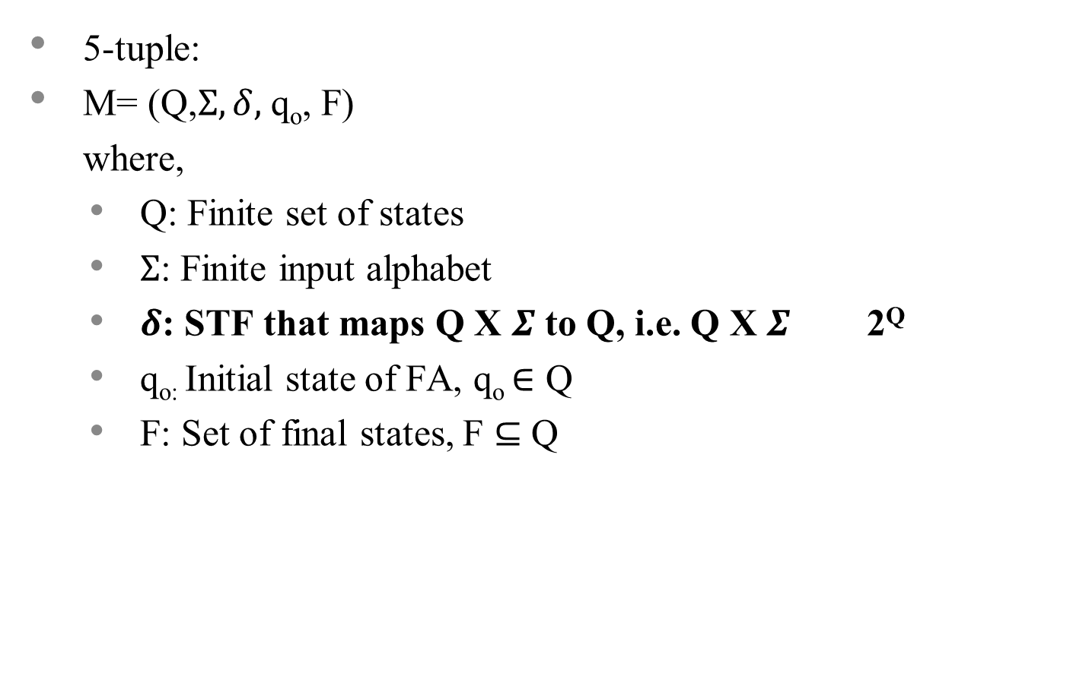
Non-Deterministic Finite Automata (cont…)

Slide 66
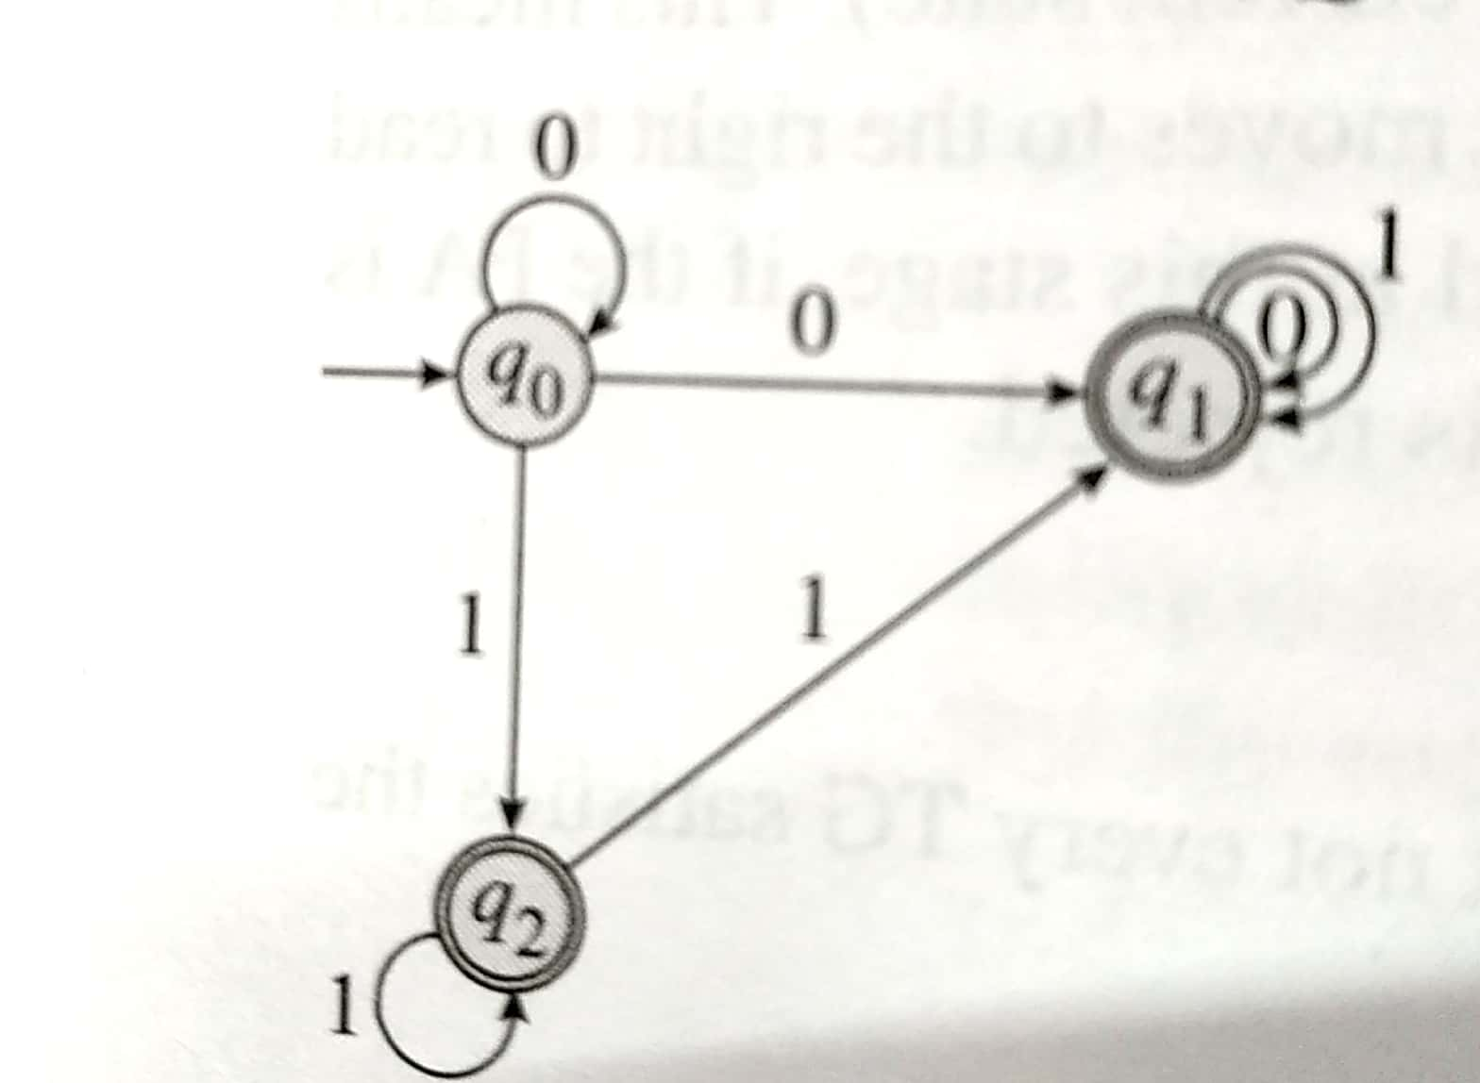
Non-Deterministic Finite Automata (cont…)
Example:
Transition Graph for example NFA

Slide 67
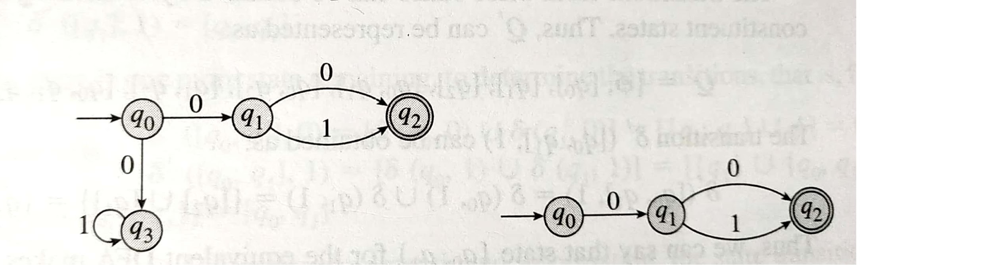
Equivalence of NFA and DFA
Example:
NFA vs DFA
Example NFA
Equivalent DFA
NFA and DFA have equal powers

Slide 68
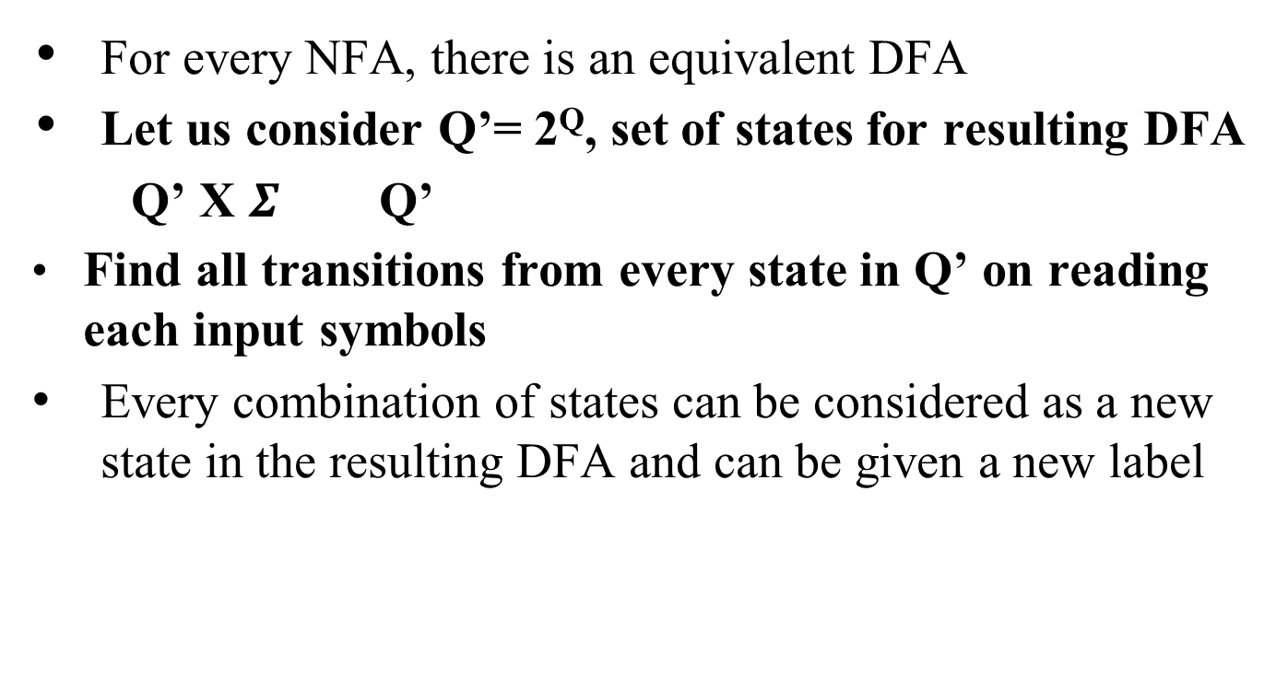
Conversion of NFA to DFA (Method I)

Slide 69
Conversion of NFA to DFA Method I (cont…)
In the resulting DFA, there should be a unique state resulting from an input to the previous state
The initial state remains unchanged for the resultant DFA
All possible subsets of Q (i.e. 2^{Q}) are the possible states for the resultant DFA
Final state in resulting DFA is all the states containing final state of given NFA

Slide 70
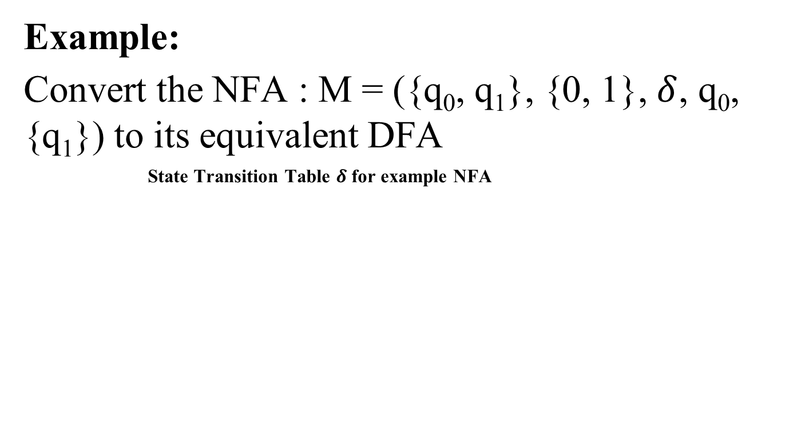
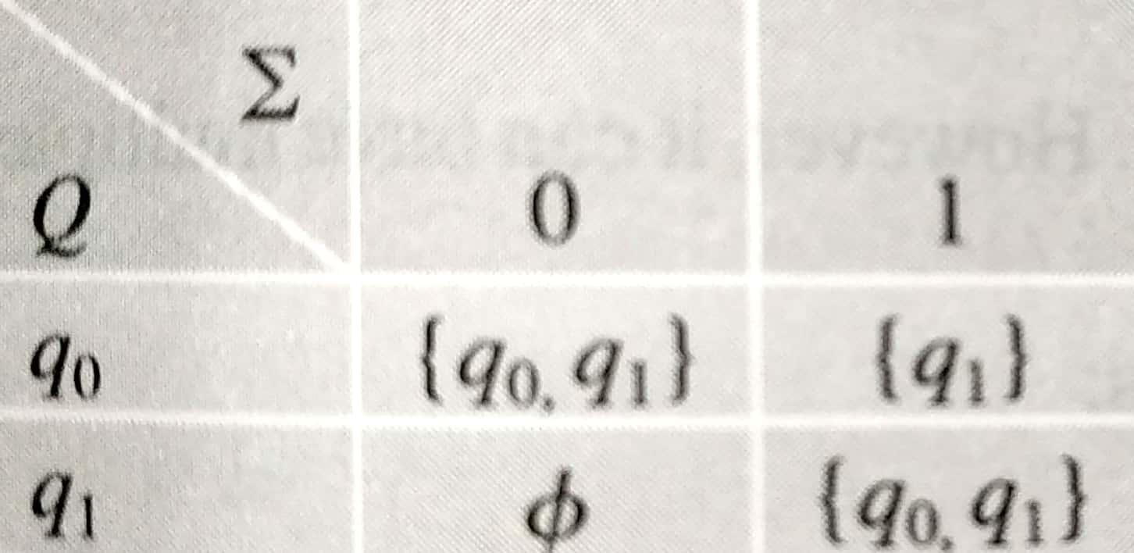
Conversion of NFA to DFA Method I (cont…)

Slide 71
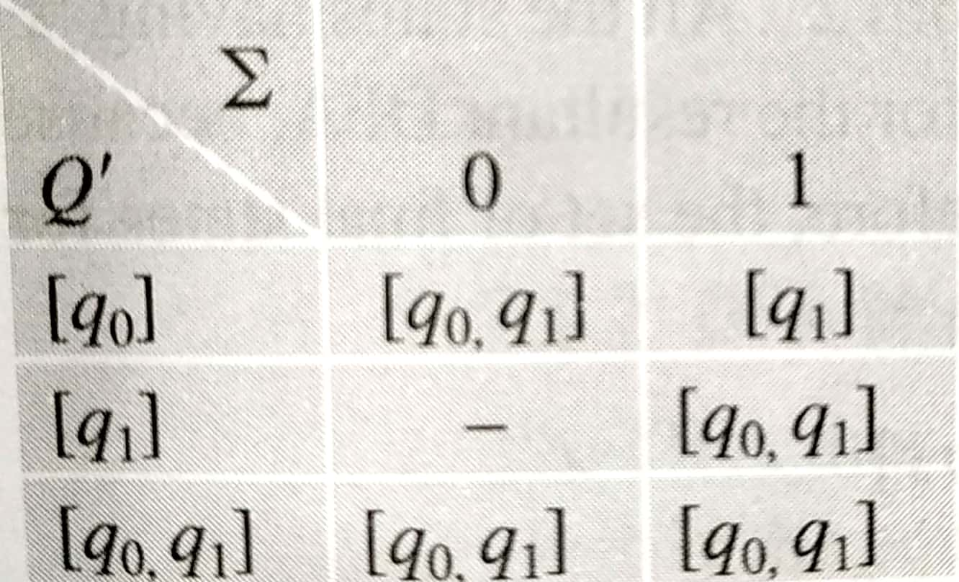
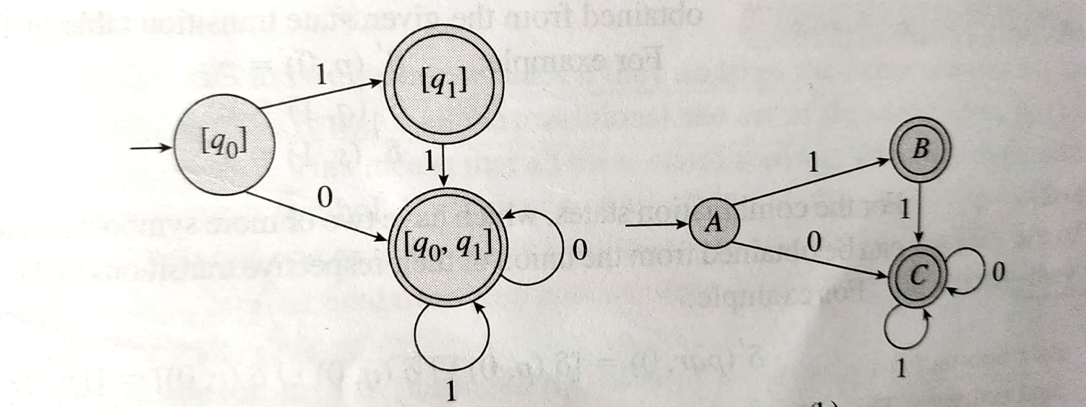
Conversion of NFA to DFA Method I (cont…)
State Transition table for resultant NFA State Transition Graph for resultant NFA

Slide 72
Conversion of NFA to DFA Method II
Easier and direct
Takes lesser number of steps and time to build an equivalent DFA
Instead of considering the set Q’=2^{Q} and then removing non-required states, consider only those states that are required

Slide 73
Conversion of NFA to DFA Method II (cont…)
Start building an equivalent DFA with the transition diagram of given NFA
Find the transition, one state at a time
If the next state of a given transition is a new combination, add that to the set of states for the resultant DFA

Slide 74
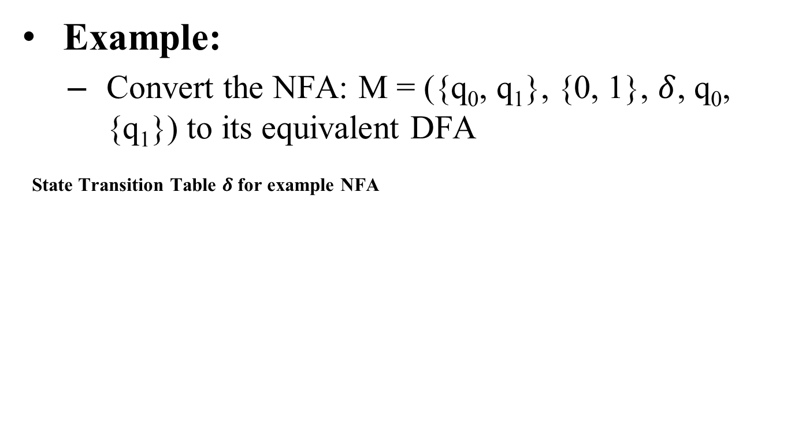
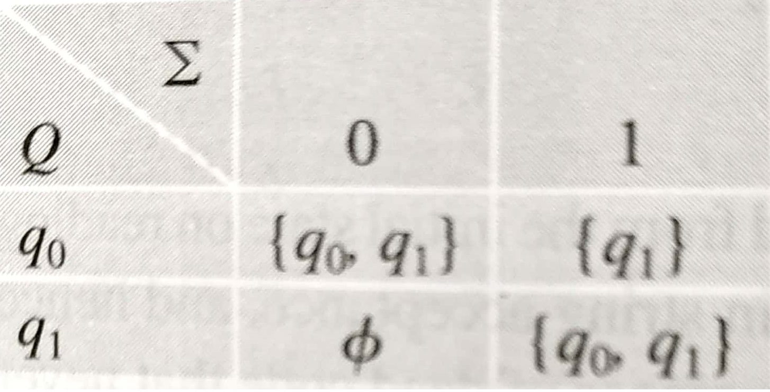
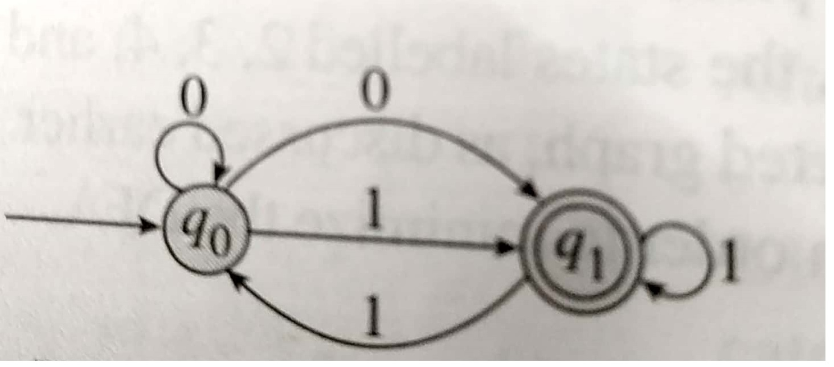
Conversion of NFA to DFA Method II (cont…)
Transition Graph for example NFA

Slide 75
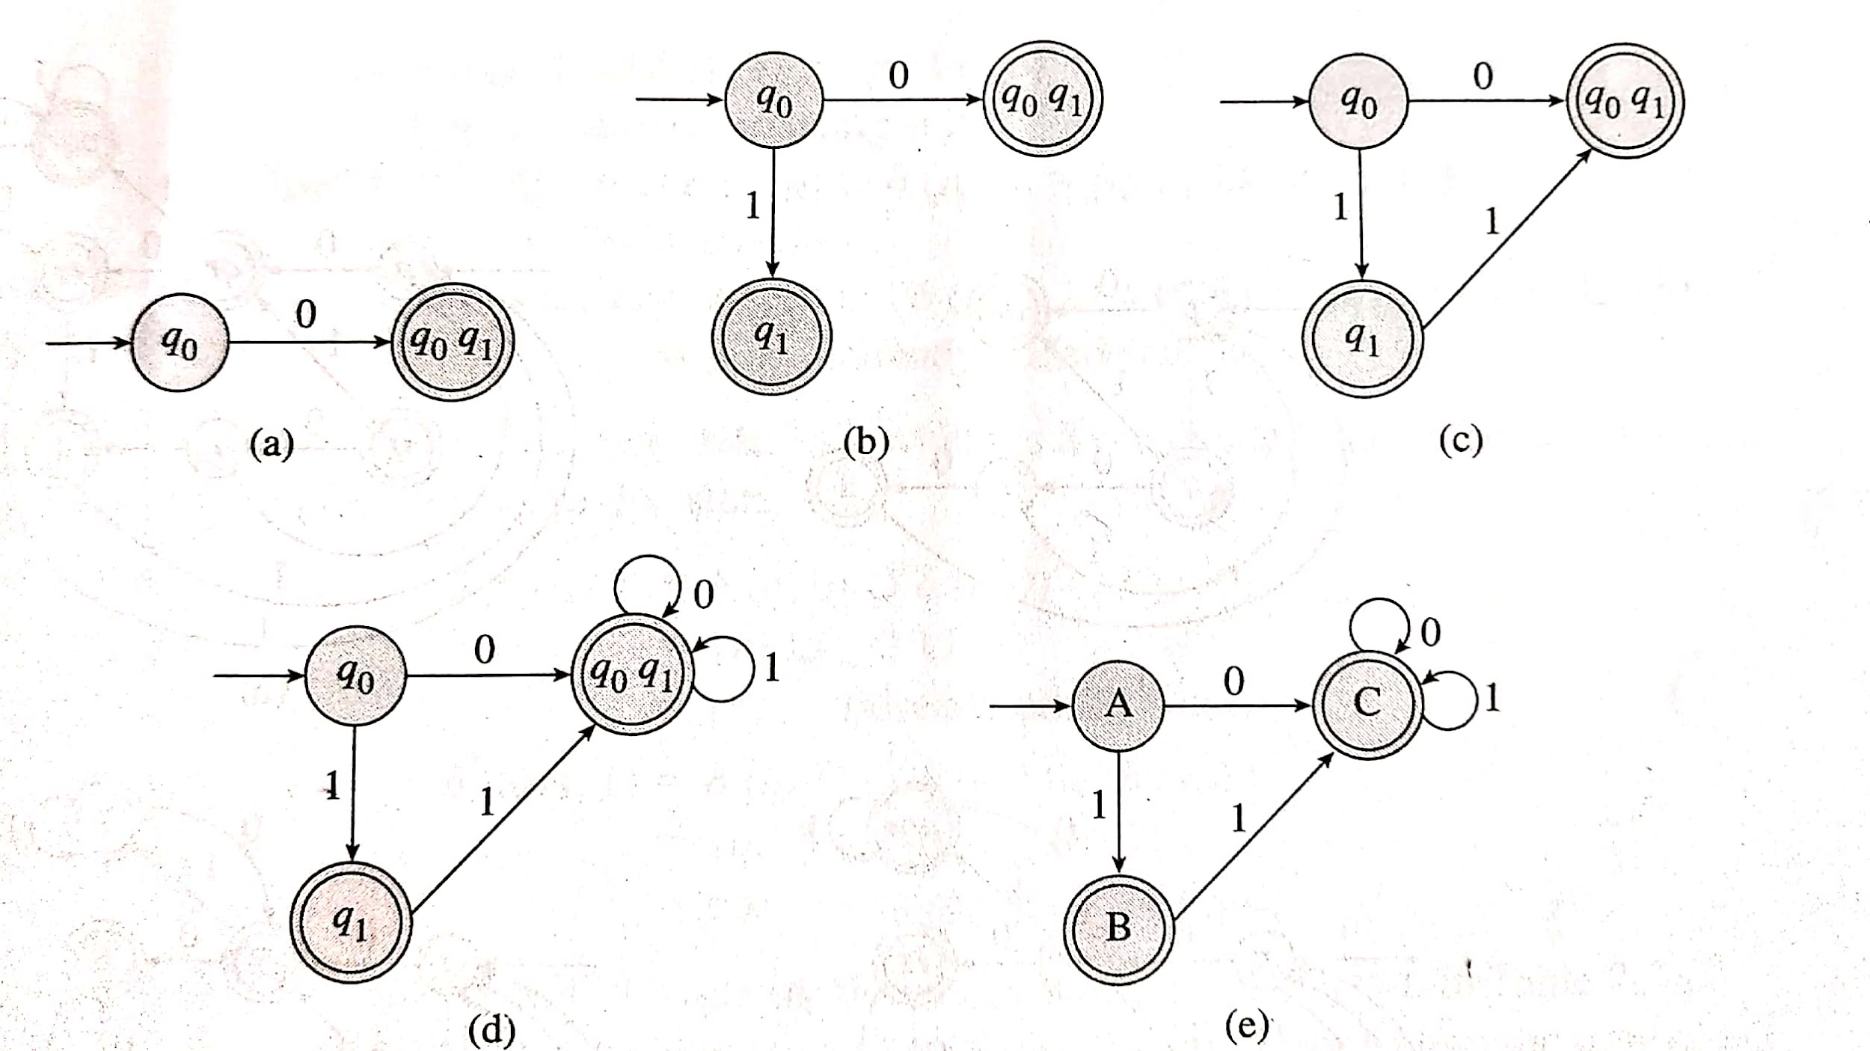
Conversion of NFA to DFA Method II (cont…)
DFA construction from the given NFA:
(a) Step 1 (b) Step 2 (c) Step 3 (d) Step 4 (e)Final DFA

Slide 76
DFA Minimization
Identify equivalent states and keep any one of them.
Replace remaining states by that one.
Identify unreachable states and remove them
Identify dead (or trap) states and remove them

Slide 77
DFA Minimization (cont..)
Equivalent states:
go to same next state on reading the same input symbol
same type (final or non-final)
Unreachable states:
Can not be reached from initial state on reading any input symbol
Dead (or Trap) states:
Have no outgoing transitions, except to themselves

Slide 78
DFA Minimization Rules
One non-final state can be replaced by its equivalent non-final state only
One final state can be replaced by its equivalent final state only
Initial state can not be replaced by any other state
One final state can not be replaced by a non-final state or one non-final state can not be replaced by a final state

Slide 79
DFA Minimization Rules (cont…)
Replacing state A by state B means deleting all entries related to state A i.e. deleting all the transitions for state A from the state transition table.
If more equivalent states are found after applying all the rules, repeat the same five steps to further reduce the DFA.

Slide 80
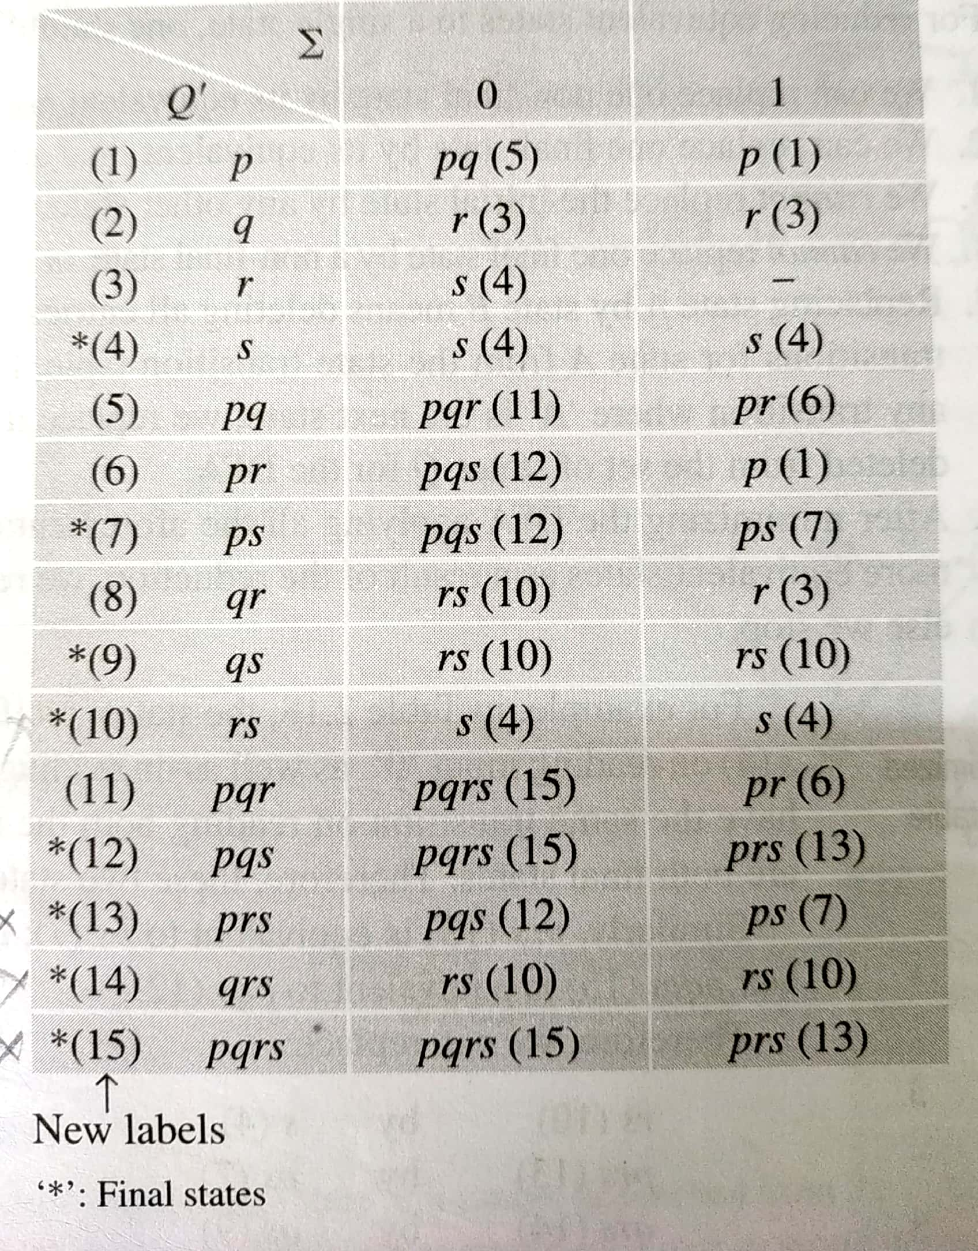
DFA Minimization (cont…)
State Transition Table of the DFA to be minimized

Slide 81
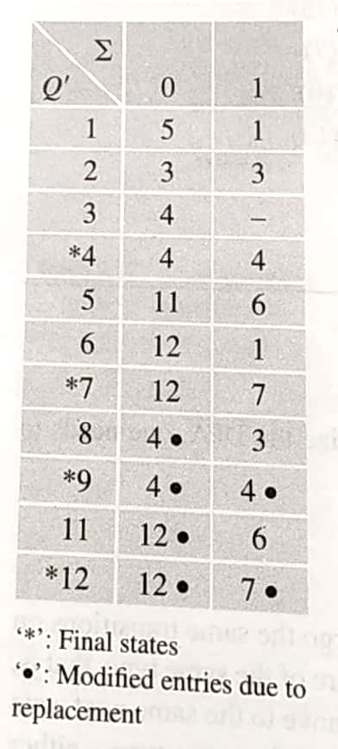
DFA Minimization (cont…)
Minimized DFA

Slide 82
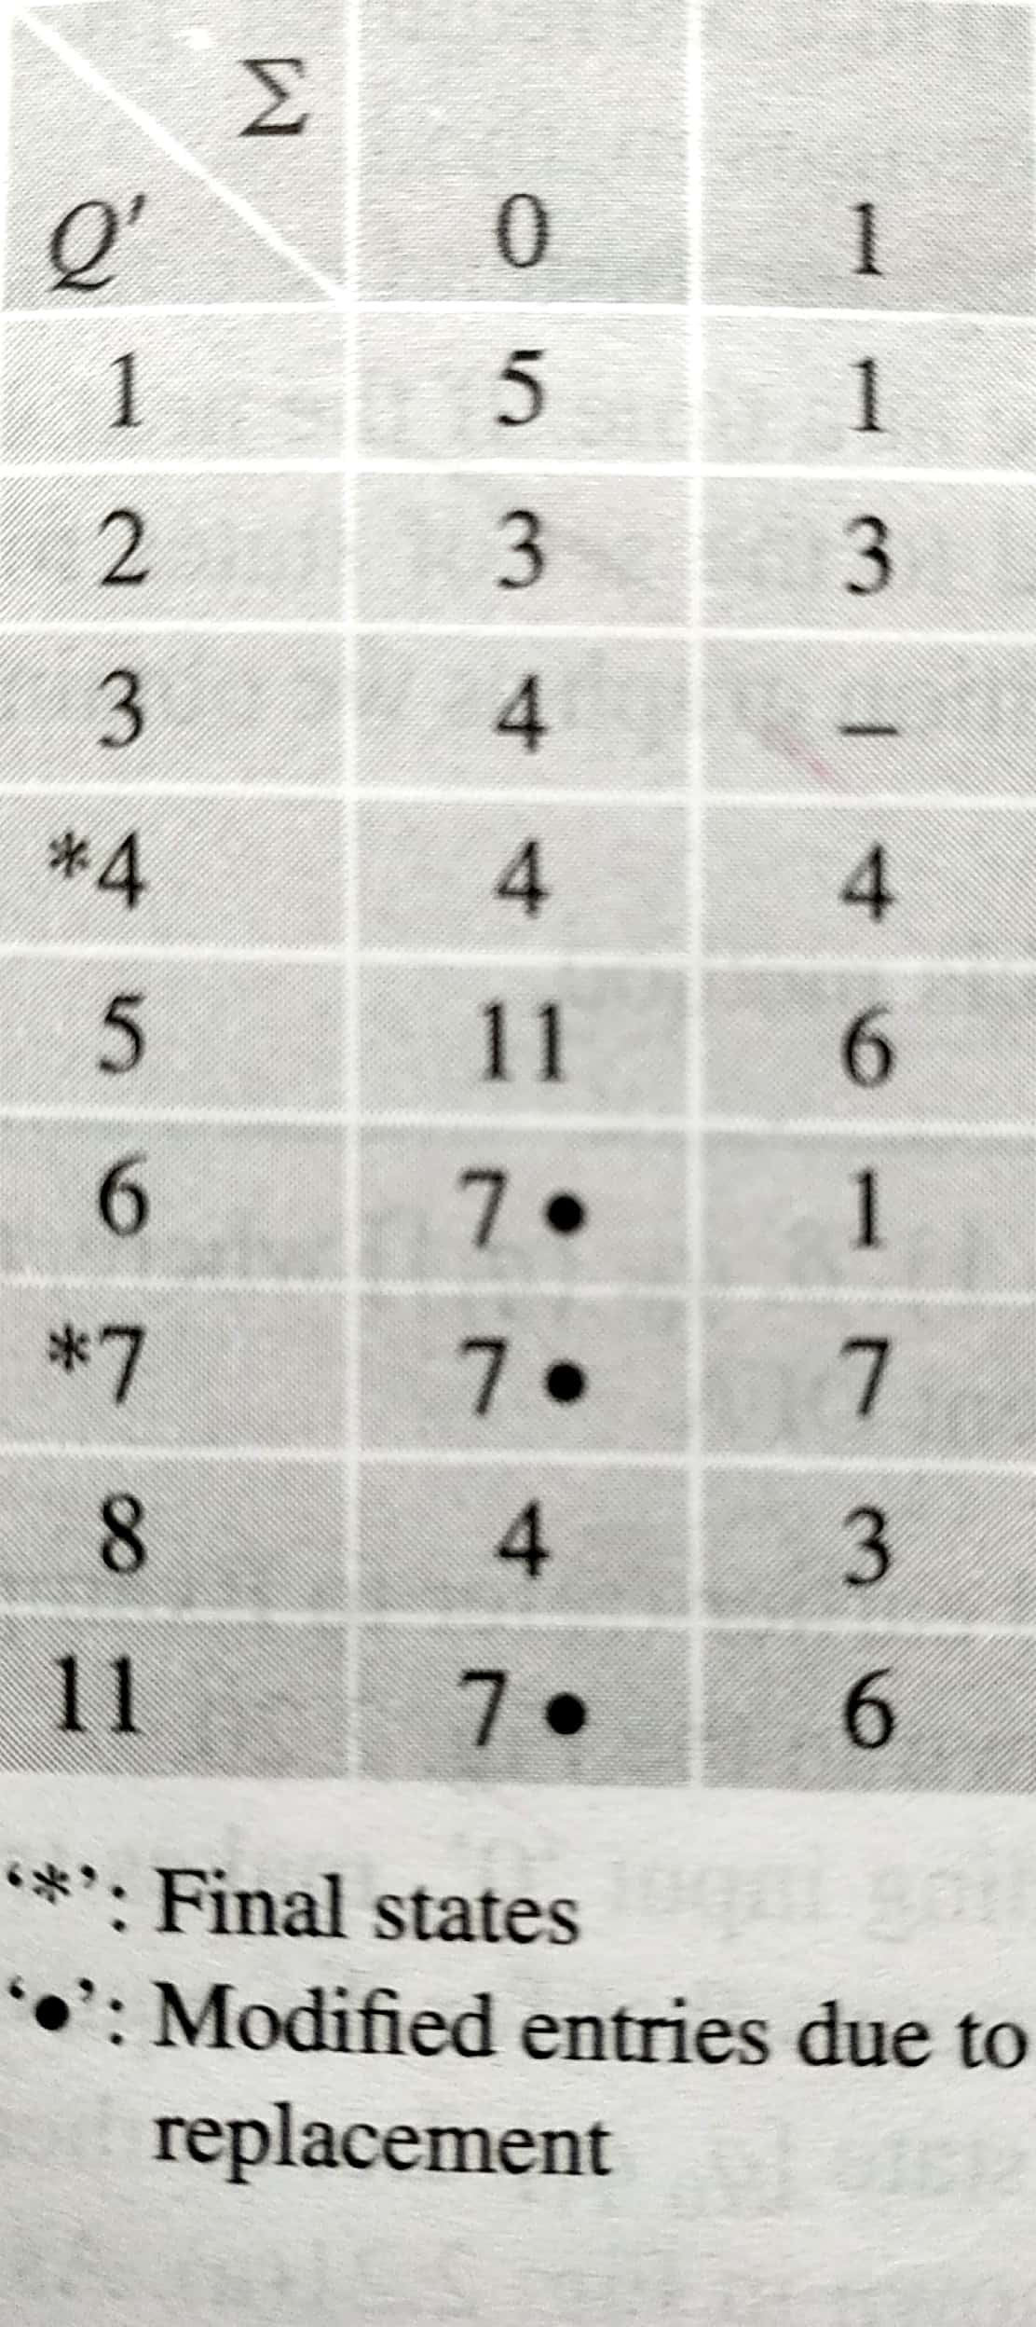
DFA Minimization (cont…)
Further minimized DFA

Slide 83

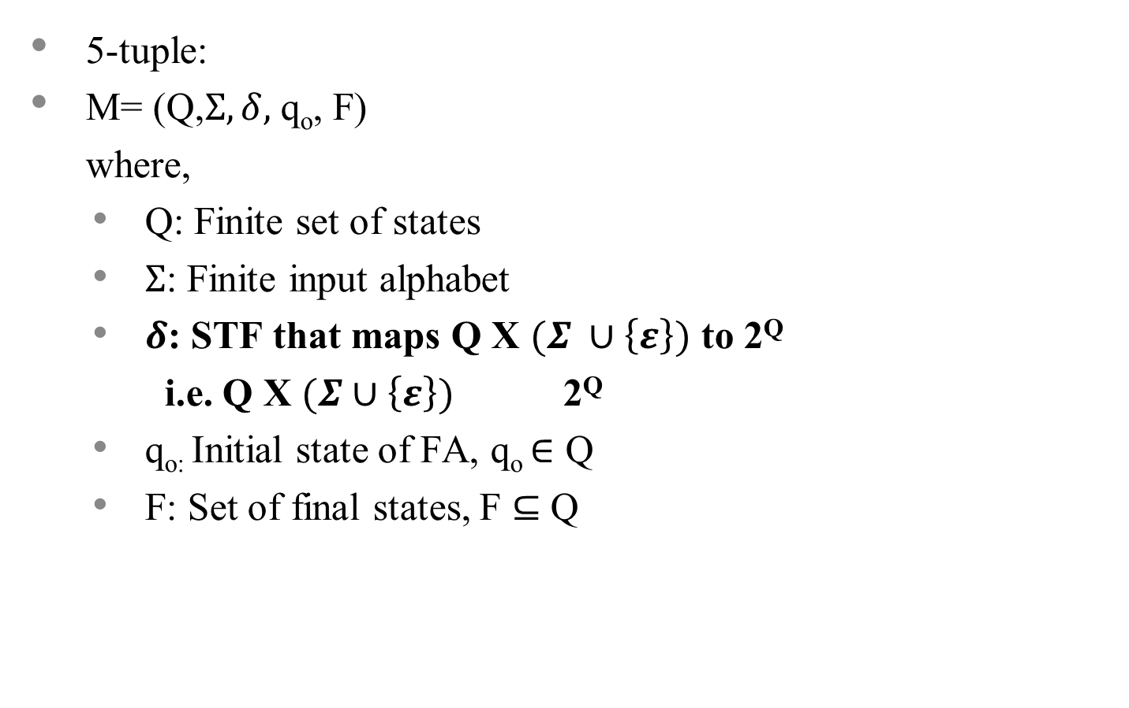

Slide 84

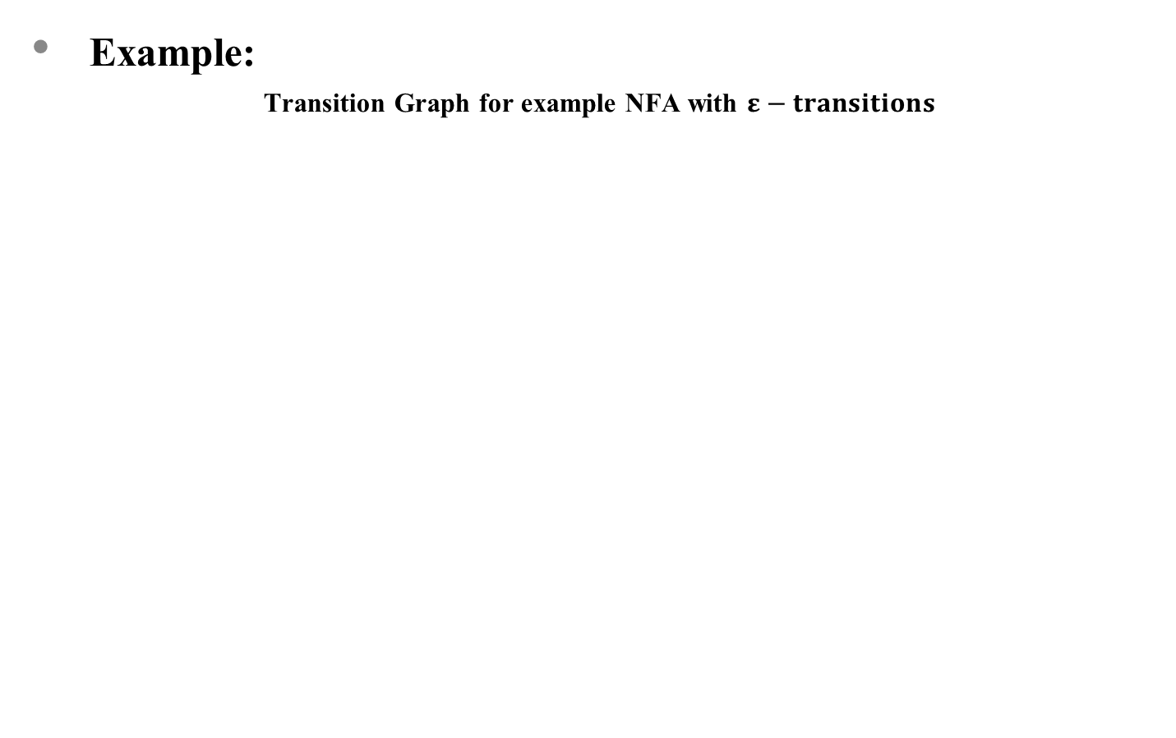
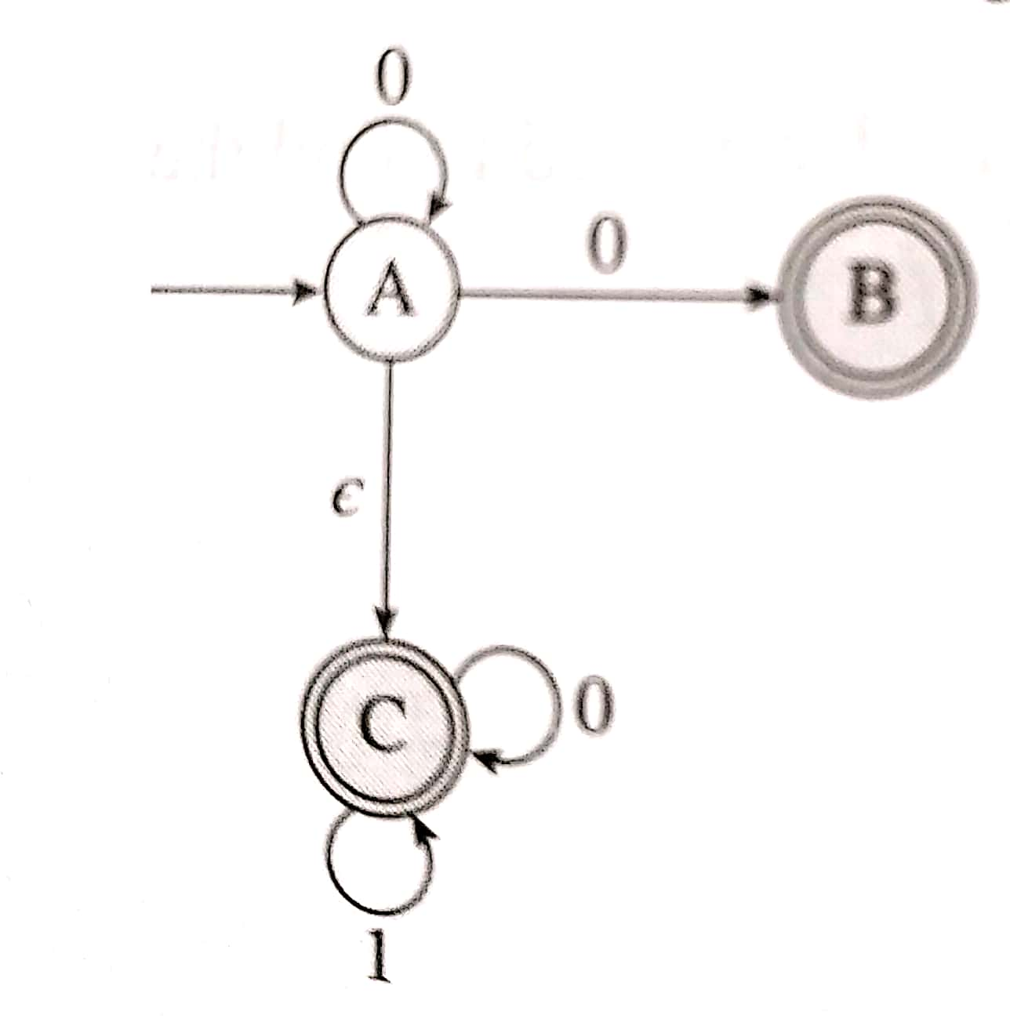

Slide 85
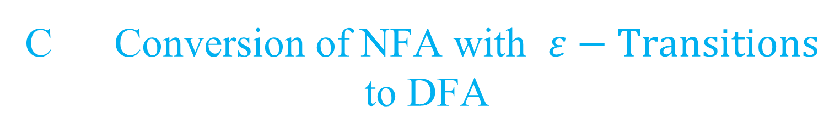

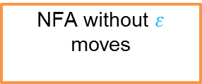
Indirect Conversion Method
Direct Conversion Method
Indirect Method
Direct Method
Indirect Method
Direct Method
Equivalent DFA

Slide 86
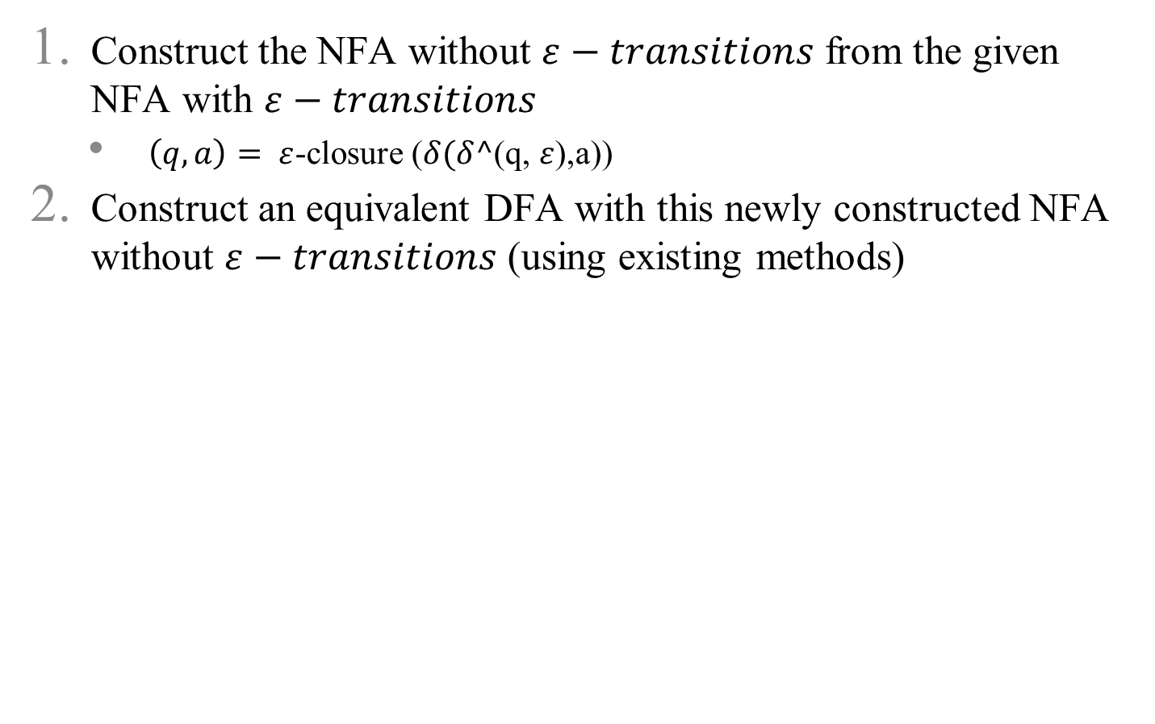
Indirect Conversion Method

Slide 87
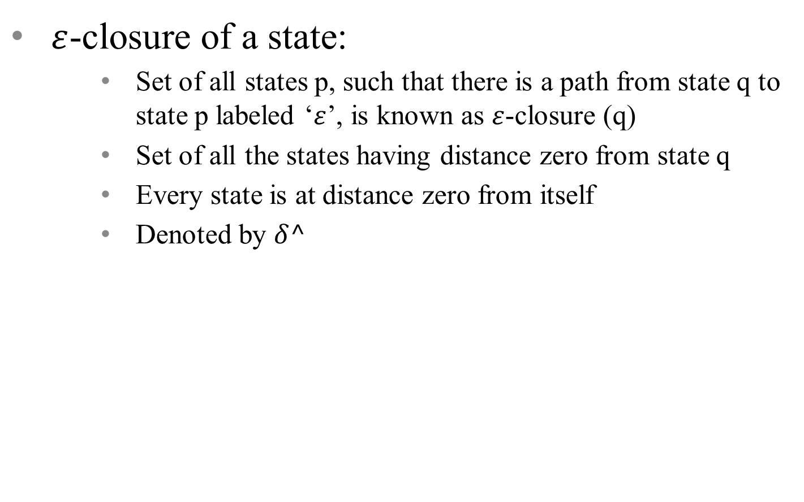
Indirect Conversion Method (cont…)

Slide 88

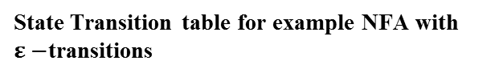
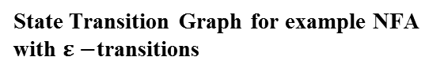
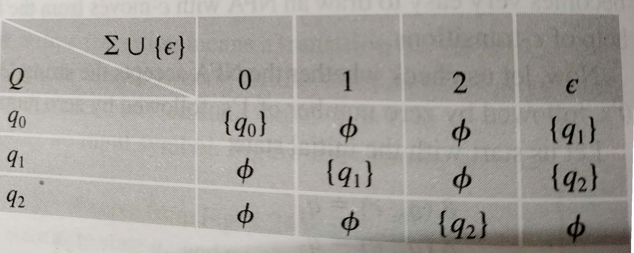
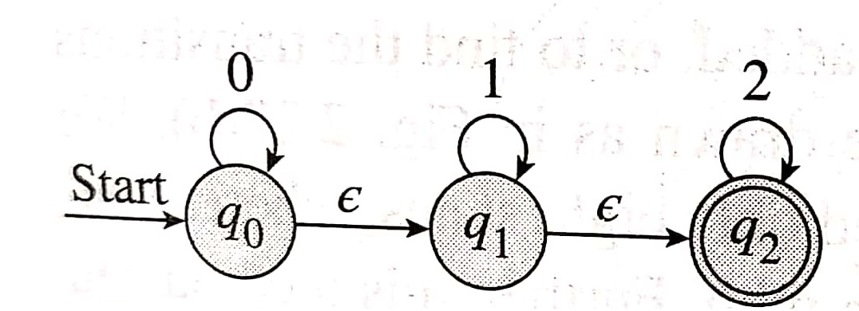
Indirect Conversion Method (cont…)

Slide 89
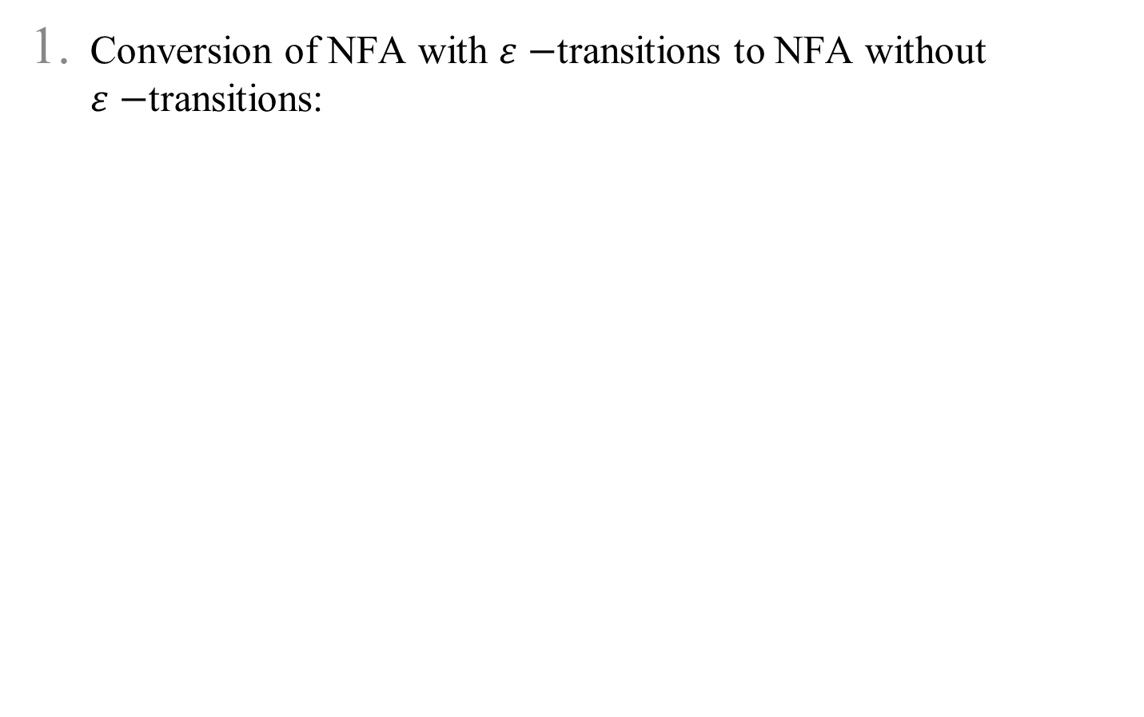
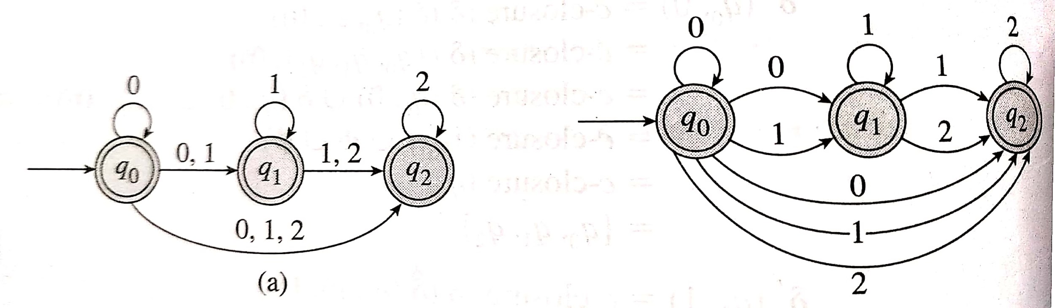
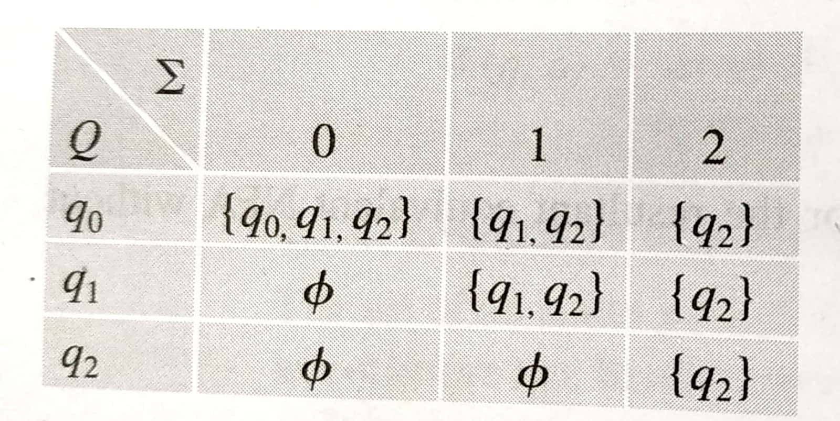
Indirect Conversion Method (cont…)

Slide 90
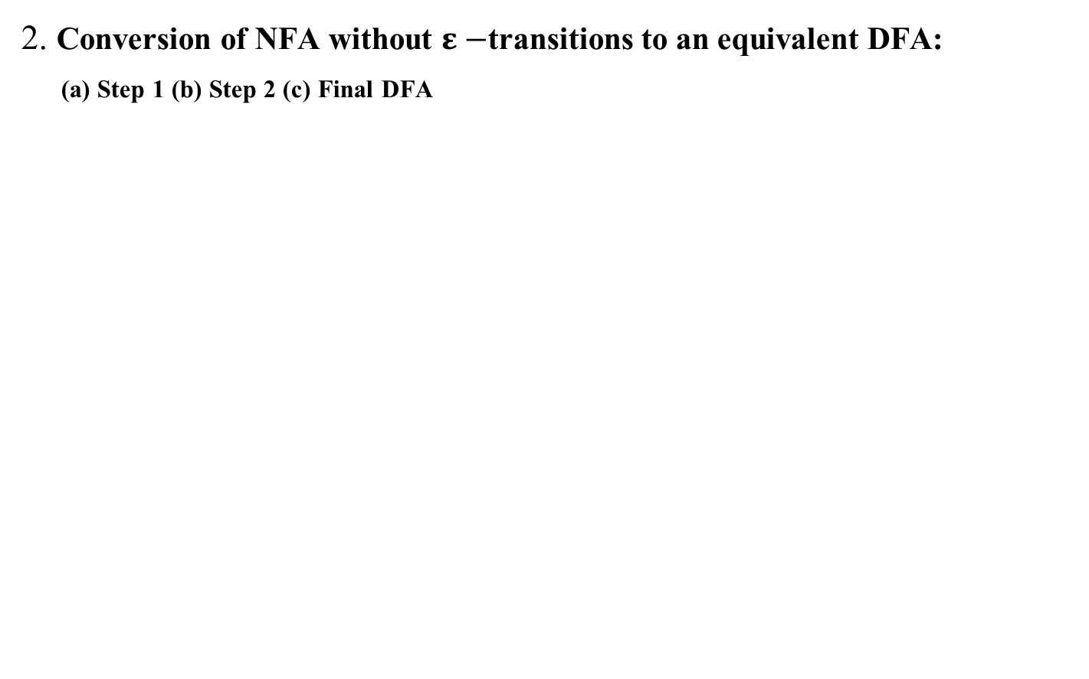
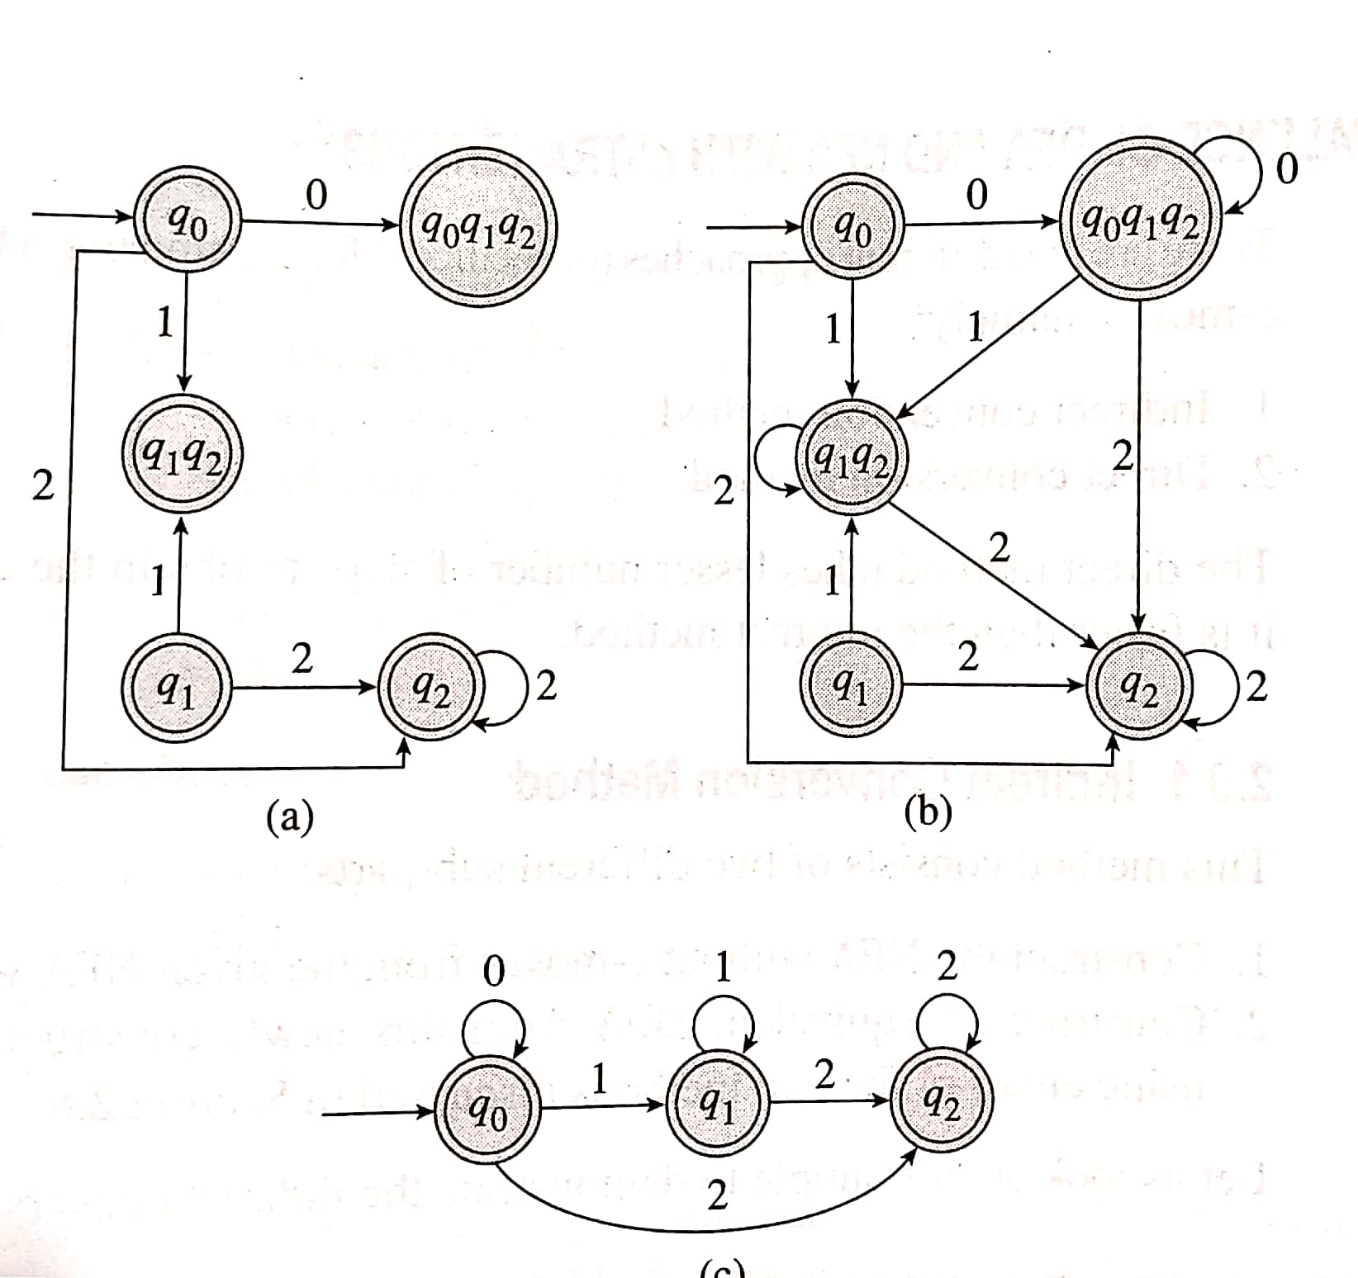
Indirect Conversion Method (cont…)

Slide 91
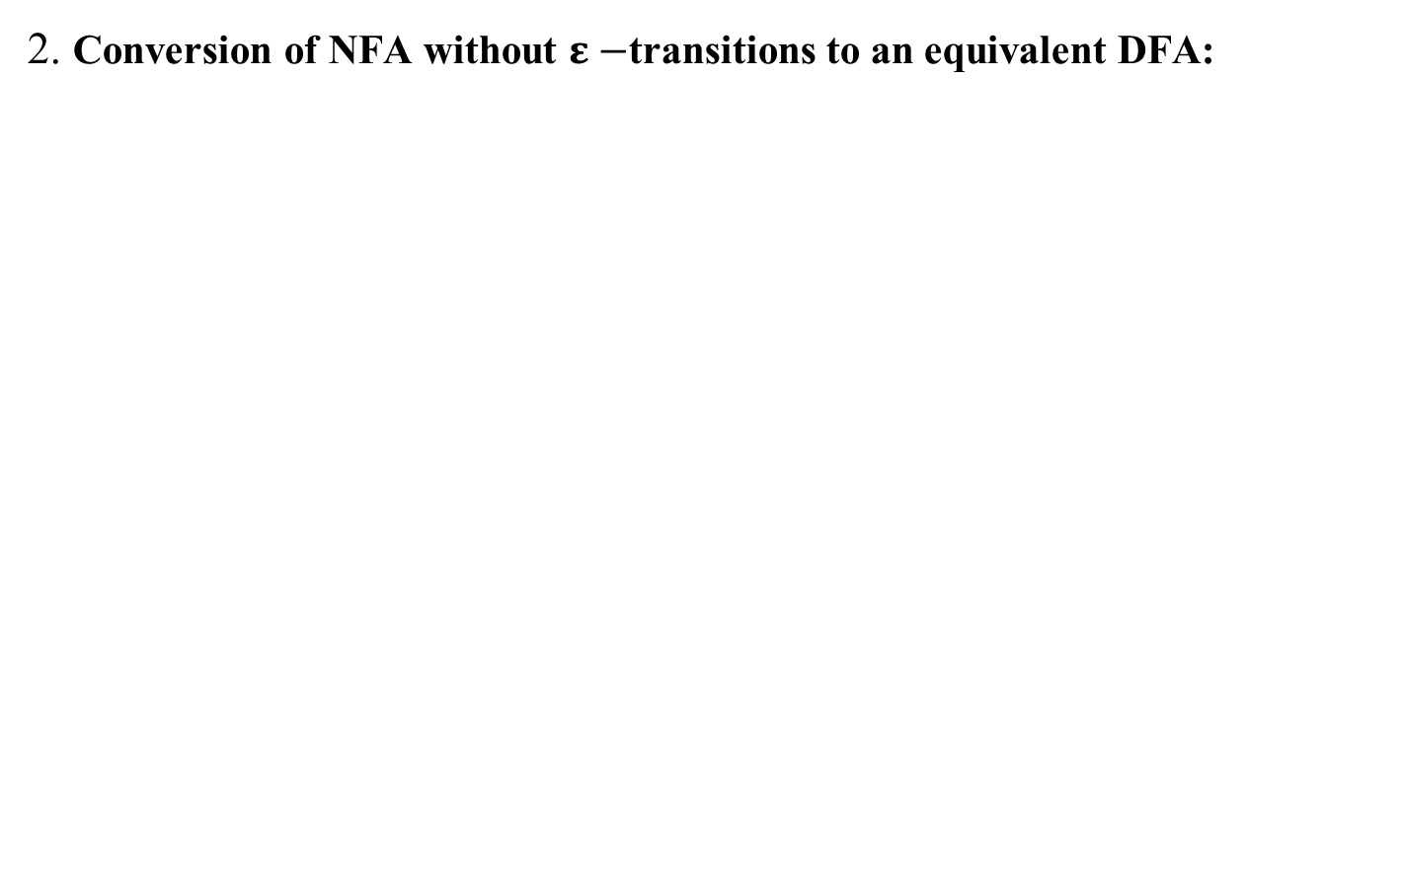
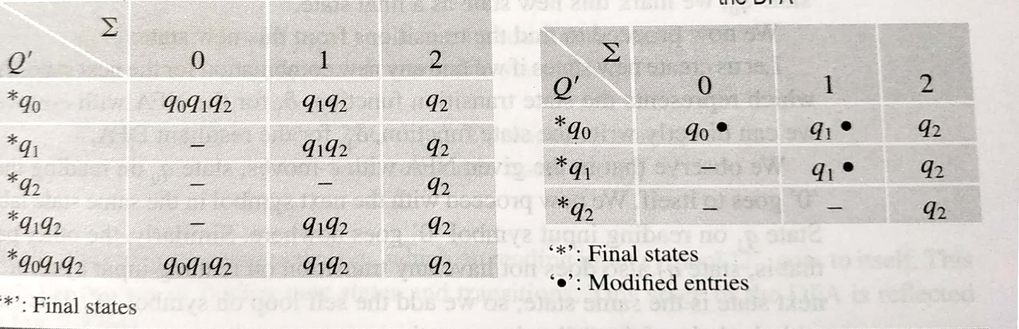
Indirect Conversion Method (cont…)
State Transition table for the equivalent DFA
Reduced State Transition table for the equivalent DFA

Slide 92
Direct Conversion Method
Begin with the initial state
Go on adding the states as & when required to the diagram
Follow the same process until there exists no state without having the transitions specified
Each state label consists of:
Name of state label
Combination of all the state symbols, which are reachable from the given state

Slide 93
Direct Conversion Method (cont…)
Start building an equivalent DFA with the transition diagram of given NFA
Find the transition, one state at a time
If the next state of a given transition is a new combination, add that to the set of states for the resultant DFA

Slide 94

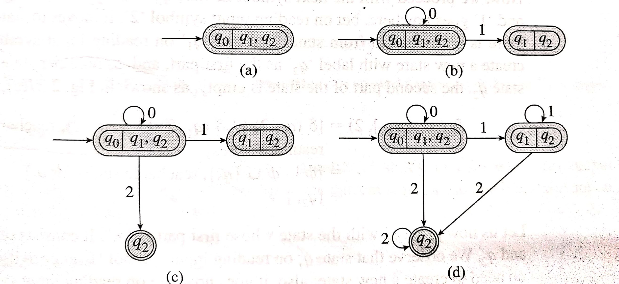
Direct Conversion Method (cont…)

Slide 95
Finite Automata with Output
FSM with output and machine function (MAF)
Moore Machine
Mealy Machine

Slide 96
Moore Machine
The output symbol at any given time depends only upon the current state of the machine (and not on the input symbol read)
An output symbol is associated with each state
When the machine is in particular state, it generates the output, irrespective of the input that caused the transition

Slide 97
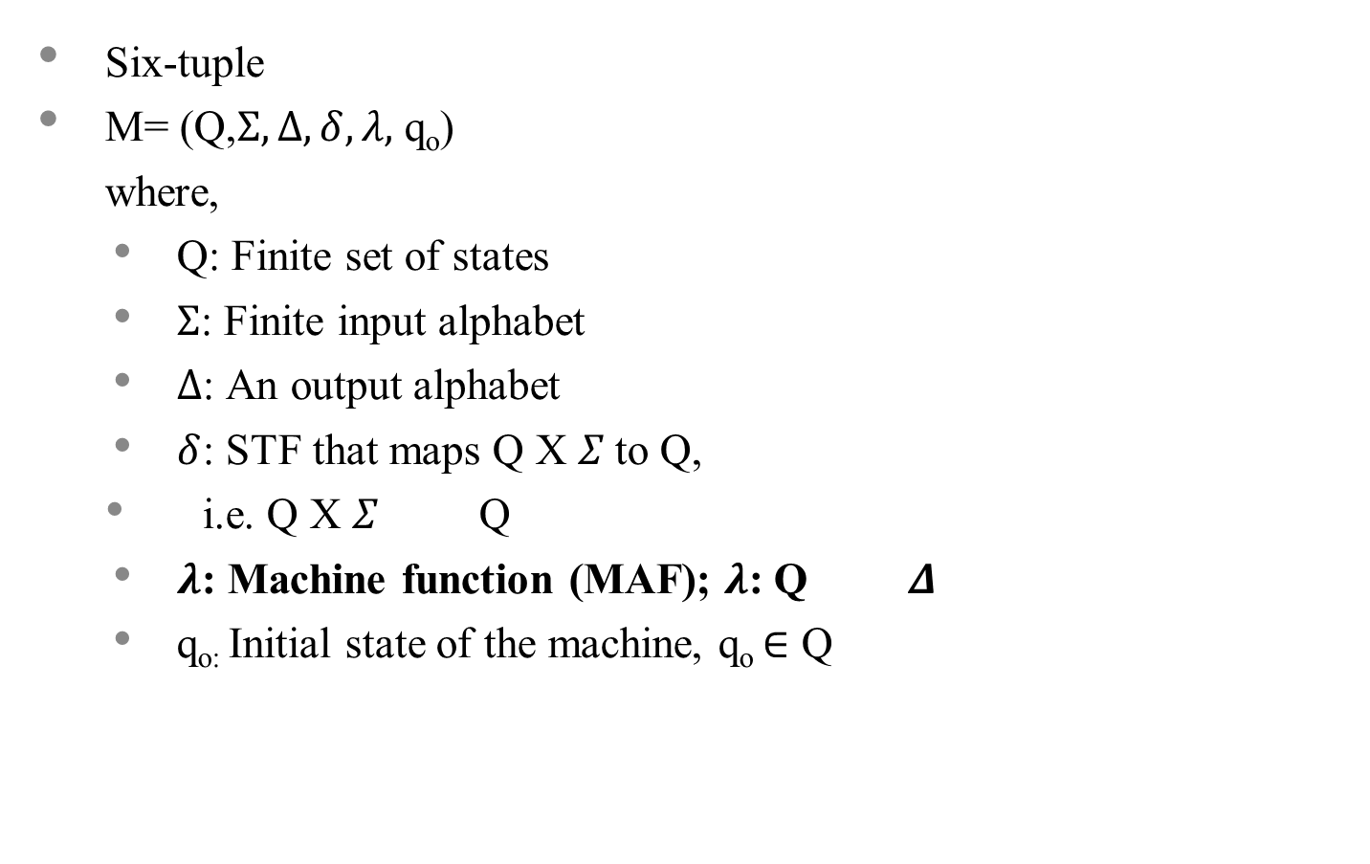
Moore Machine (cont…)

Slide 98
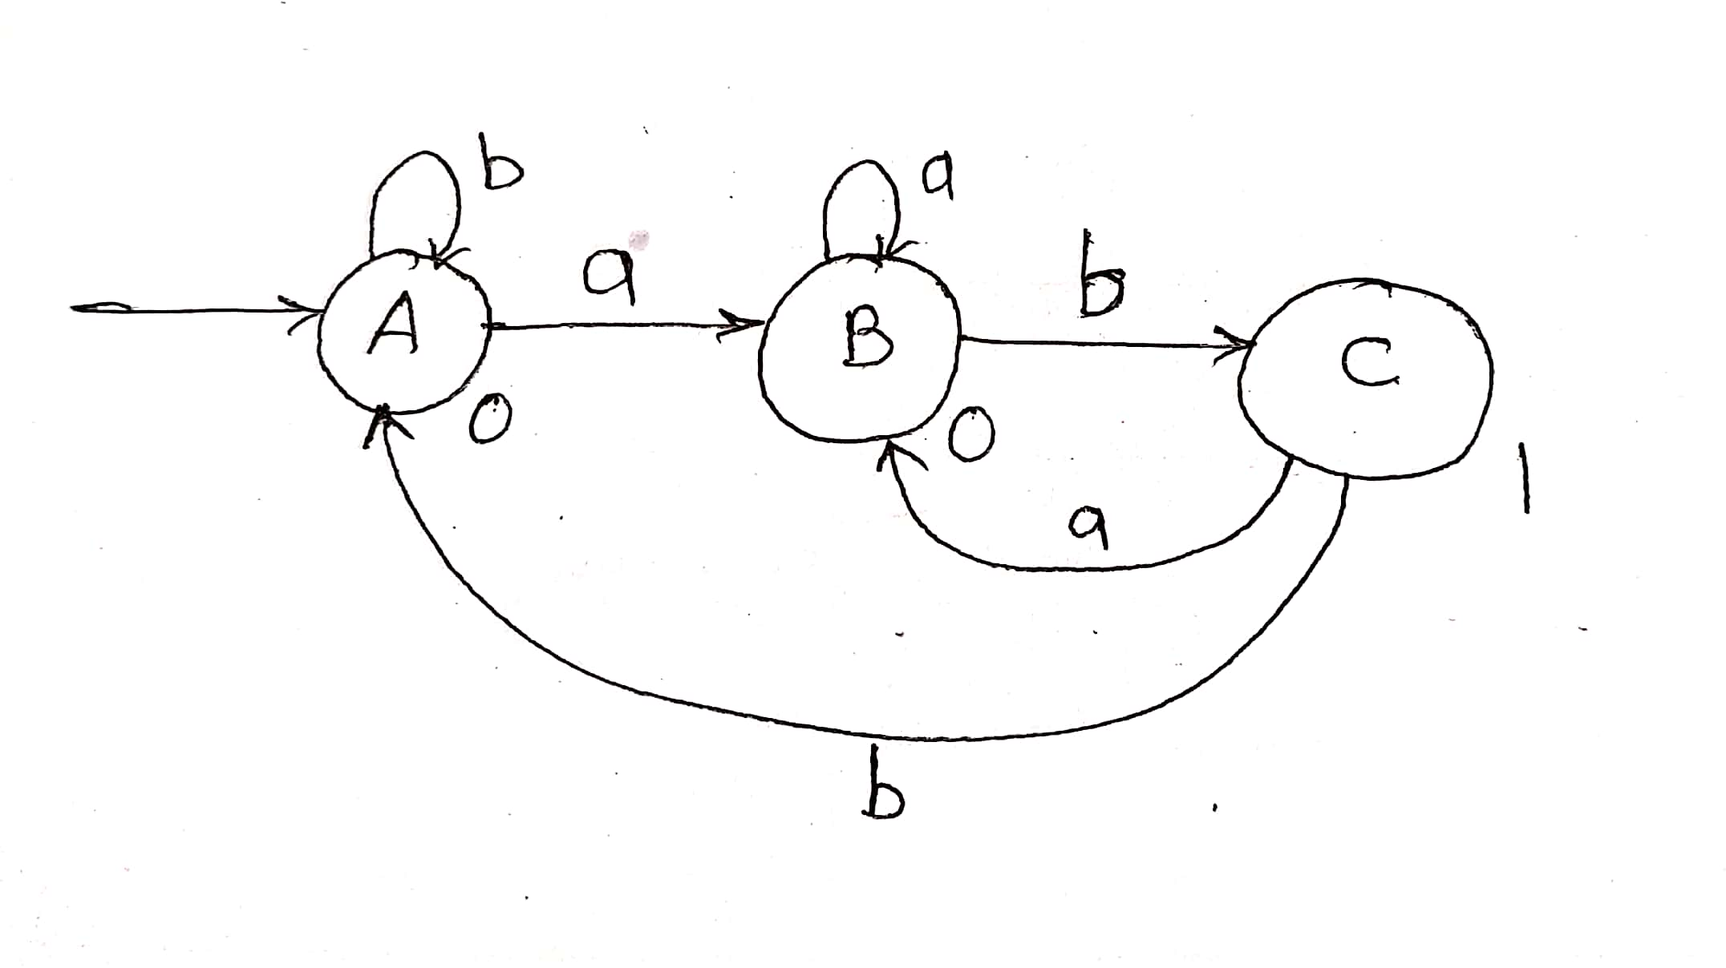
Moore Machine (cont…)
Example:
Construct a Moore machine that takes set of all strings over {a,b} as an input and prints ‘1’ as an output for every occurrence of ‘ab’ as a substring
Example Moore Machine

Slide 99
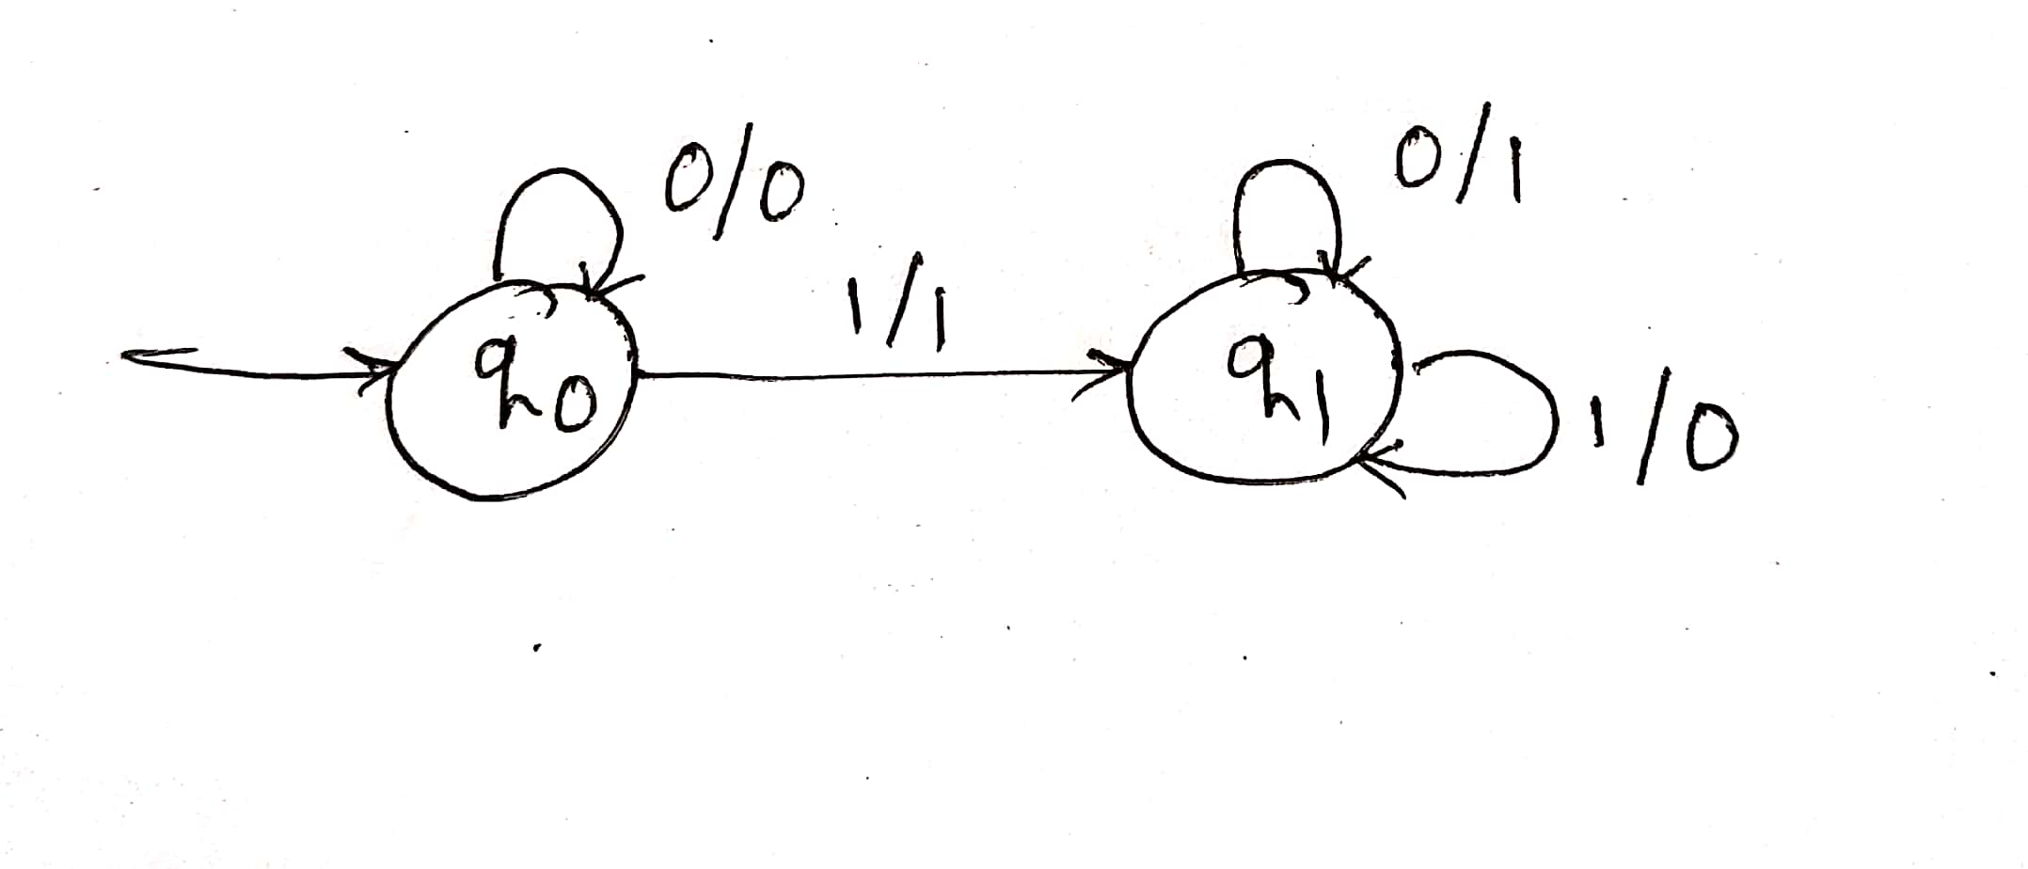
Mealy Machine
A machine with finite number of states, and for which the output symbol at any given time is a function of (i.e. it depends on) the current input symbol as well as the current state of the machine
Example:
Construct a Mealy machine to find 2’s complement of a given binary number
Example Mealy Machine

Slide 100
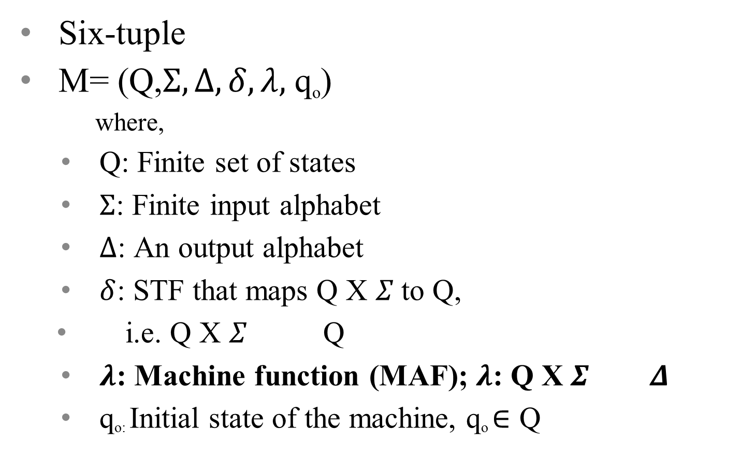
Mealy Machine (cont…)

Slide 101
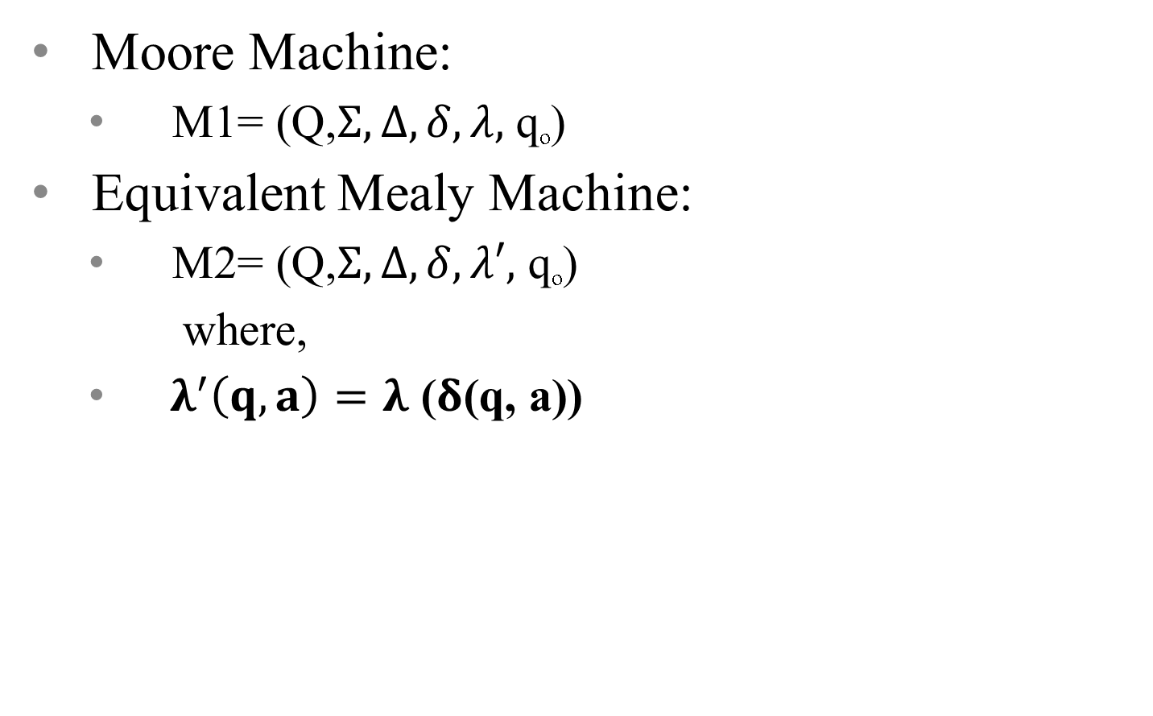
Conversion of Moore Machine to Mealy Machine

Slide 102
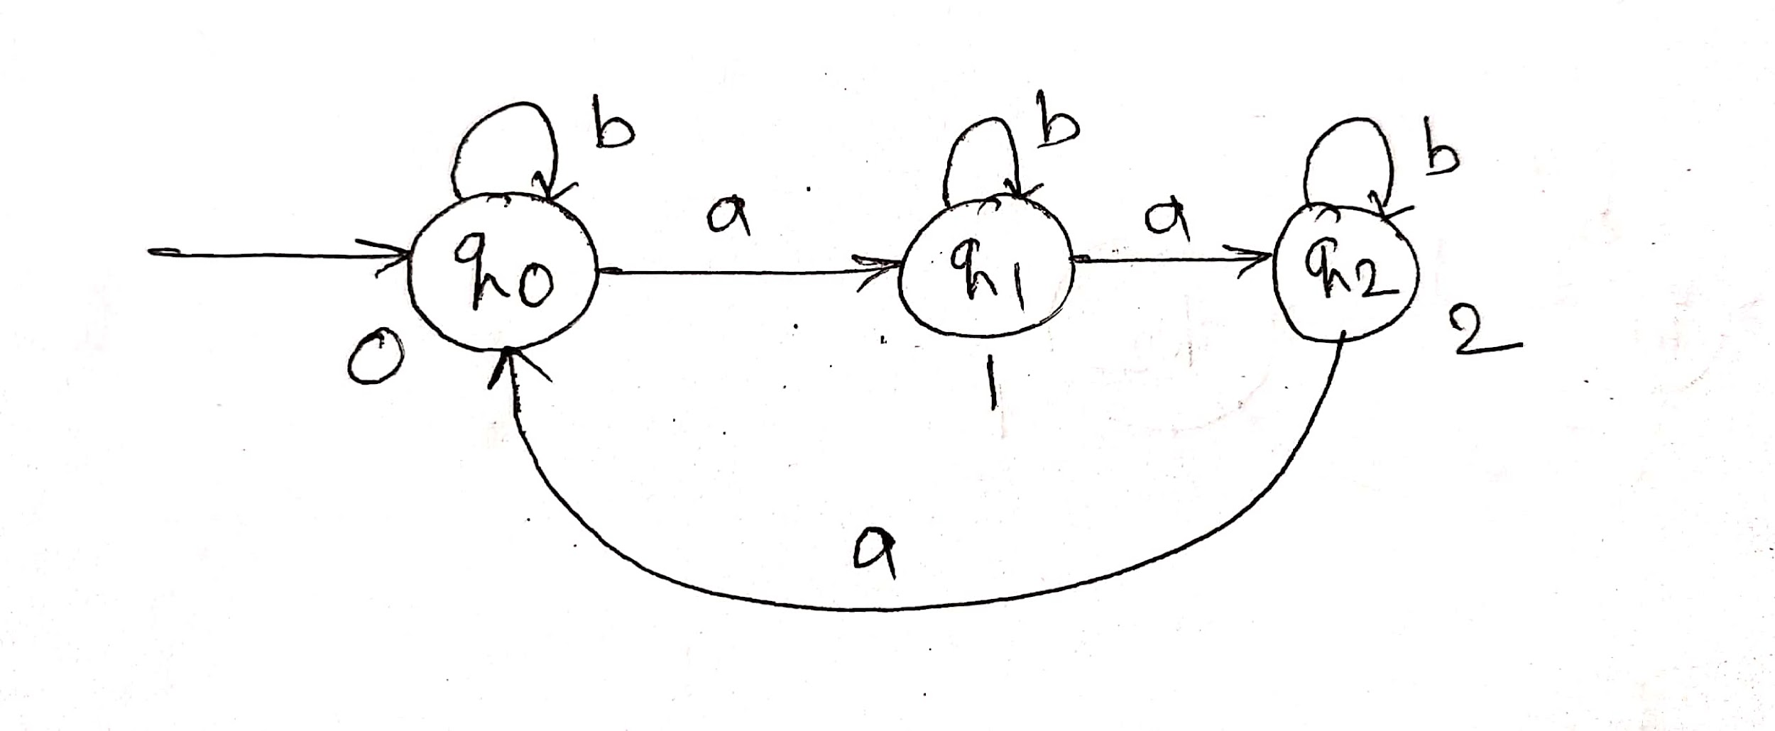
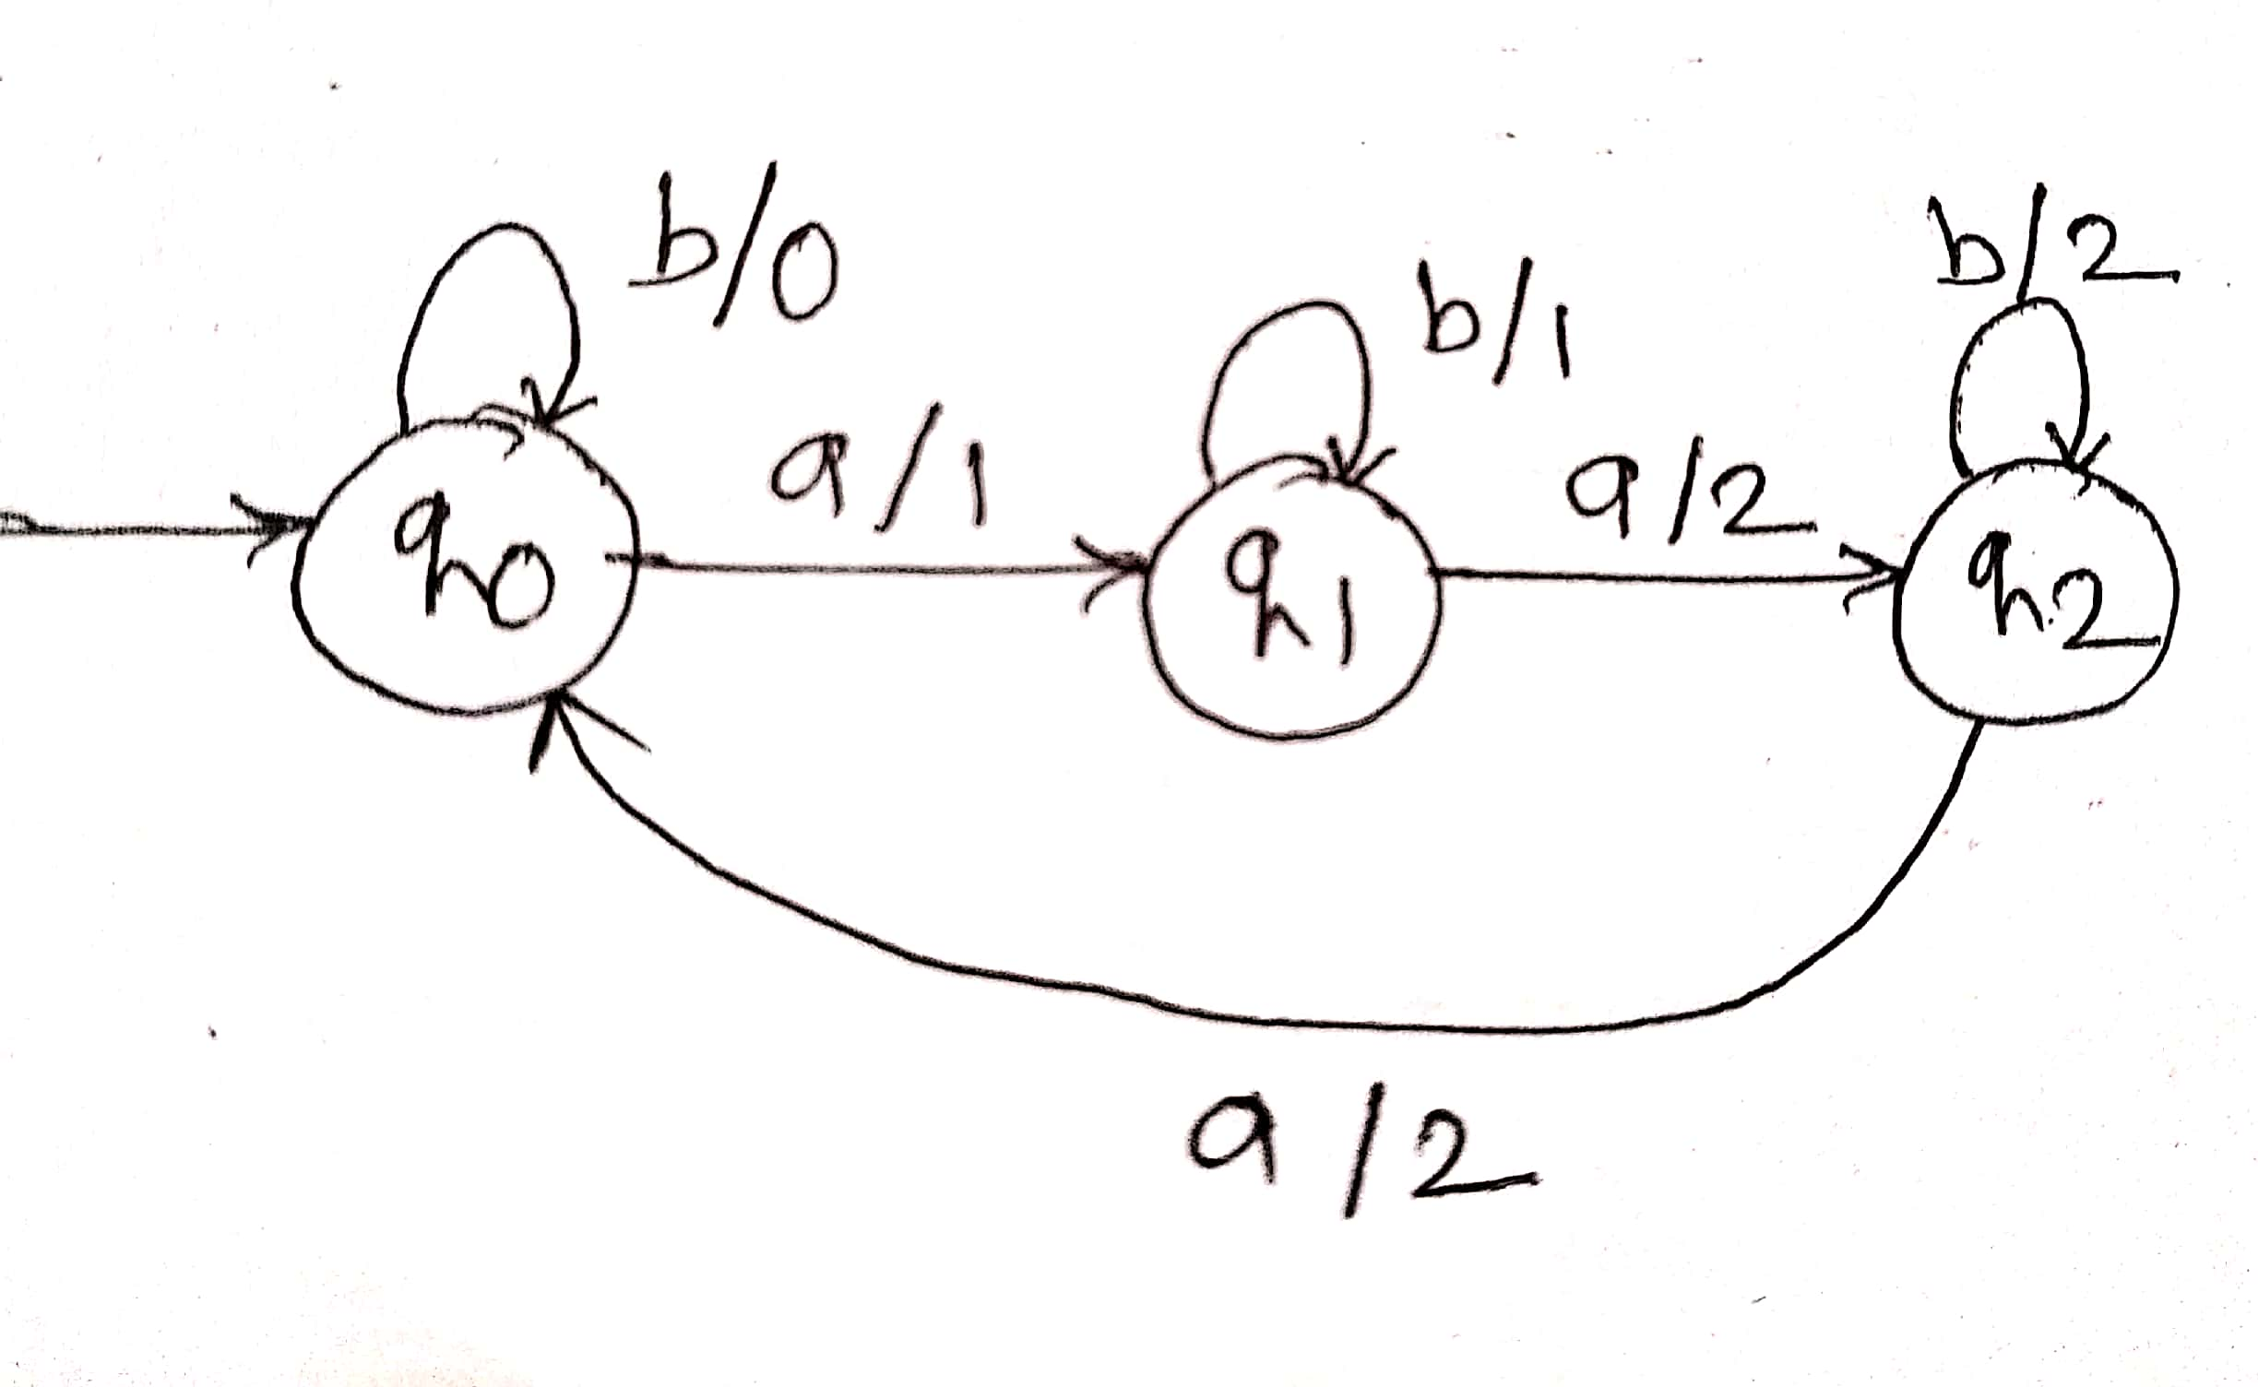
Conversion of Moore Machine to Mealy Machine (cont…)
Example:
Convert the given Moore machine to an equivalent Mealy Machine
Example Moore Machine Equivalent Mealy Machine

Slide 103
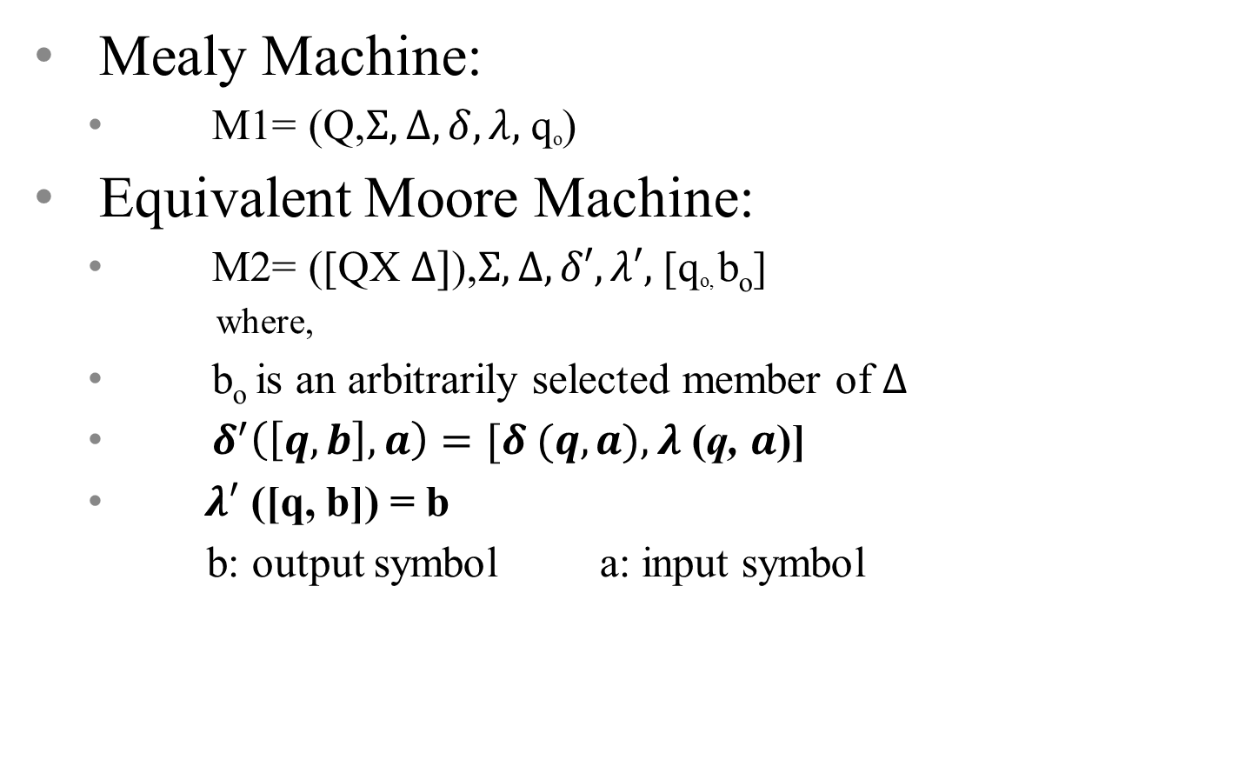
Conversion of Mealy Machine to Moore Machine

Slide 104
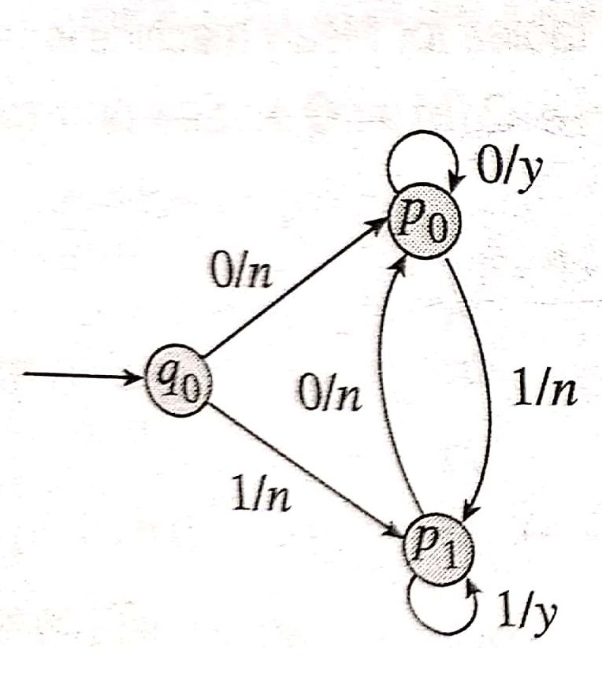
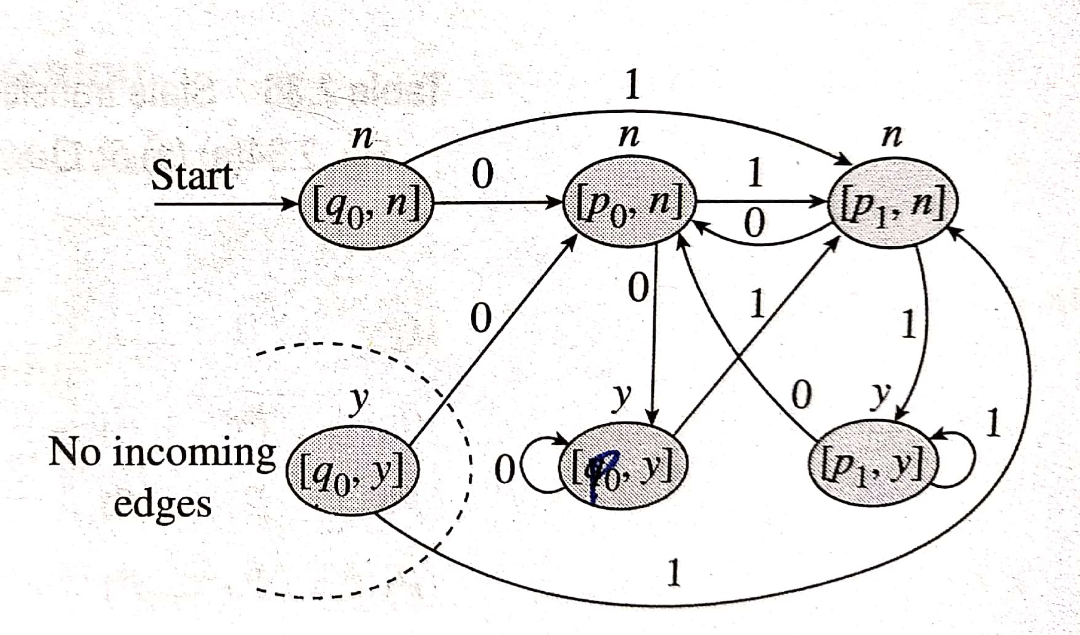
Conversion of Mealy Machine to Moore Machine (cont…)
Example:
Convert the given Mealy Machine to an equivalent Moore Machine
Example Mealy Machine Equivalent Moore Machine

Slide 105
Comparison of Moore and Mealy Machine
Moore Machine | Mealy Machine
Output depends only upon current state | Output depends upon both current input symbol and current state
Generally, it has more states than Mealy machine | Generally, it has fewer states than Mealy machine
If the input string is of length n, then the output string is of length n+1. This is because first state also produces output | If the input string is of length n, then the output string is also of length n

